Slide 1

202
Semester 2 Reports

Slide 2

Acknowledgement of Country
I would like to acknowledge the Wurundjeri people of the Kulin Nations as the traditional custodians of the land on which Jacana School for Autism is located. I pay my respects to Elders past, present and emerging.

Slide 3
What is the intent when reporting to our families?
Teachers are intended to demonstrate to families their child’s:
position on the learning continuum;
learning progress towards the achievement of IEP goals or VPC outcomes
areas for improvement
next steps in their learning

Slide 4
What do teachers report on
in Primary and Middle SS?
Classroom Teachers
English
Mathematics (*Number & Algebra and Statistics & Probability ONLY)
Personal & Social Capabilities - Self
Visual Arts (Primary and Middles)
Home Comment
Specialists
Personal & Social Capabilities - Social
Science
Music
Health & Physical Education
Visual Arts (Secondary)

Slide 5
What do teachers report on
in the Secondary SS?
Classroom Teachers
English
Mathematics (*Algebra and Measurement ONLY)
Personal & Social Capabilities (Self)
Home Comment
Specialists
Science
Visual Arts
Music
Health & Physical Education
Personal & Social Capabilities (Social)
Technologies (HOL Café and Build)

Slide 6
What do VPC teachers report on
in the Secondary SS?
Classroom Teachers
VPC Unit Outcomes (English, Literacy, WRS and PDS)
Home Comment
Specialists
Visual Arts
Health & Physical Education
Science

Slide 7

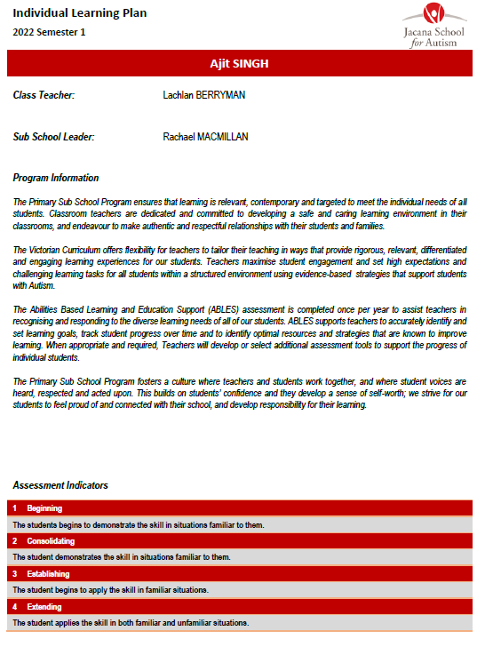

What will the report look like?
Sub-School Summary
0-3 Point Scale Assessment Indicators
with descriptions

Slide 8
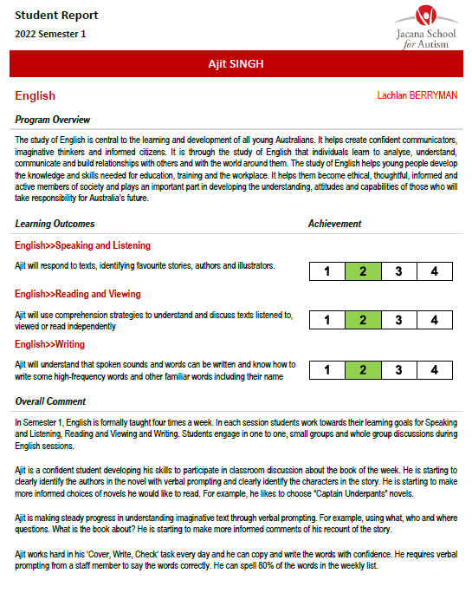
What the report will look like?
IEP Scale Scores for each content area!
Comment box:
Averaging 100-200 words per goal reported

Slide 9
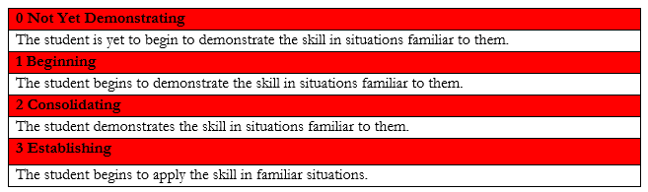
Determining Scale Scores for IEP Goals
This ‘four point’ scale enables JSA teachers with a greater level of detail to offer parents about their child’s IEP achievement and incremental progress.
Therefore, each success criteria achieved should be equal to 1 scale score.
For example, if the student achieves Success Criteria 1, then they obtain a scale score of 1, and so on until they achieve a maximum Scale Score of 3, equating to all 3 SC being achieved. At Scale Score 3, the students’ learning goal is attained.

Slide 10
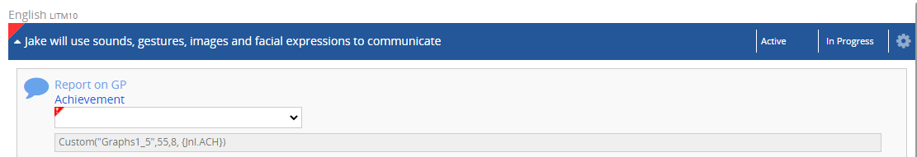
Determining Scale Scores for IEP Goals
If the scale score is marked 3, please click the ‘attained’ category found in the ‘In progress’ tab to outline that this goal has been achieved.
The achievement four-point scale is to be completed.

Slide 11
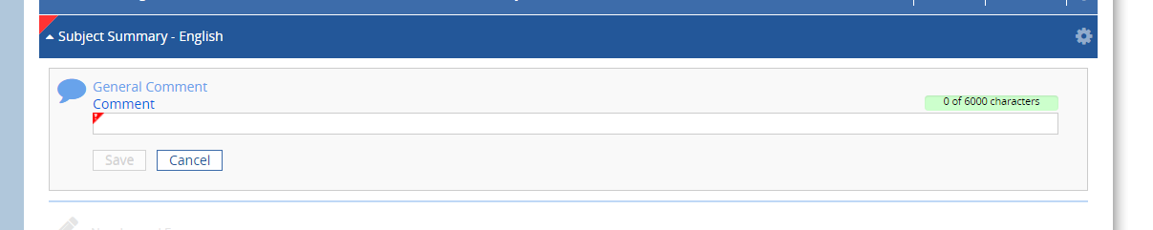
Completing The Semester 2 Report
Adding Report Comments
Complete Learning Area comment in the Subject Summary Semester 1 box.

Slide 12
Assessment: key to inform your judgements
FORMAL ASSESSMENTS
ASSESSMENT
Collection of evidence that informs us how our students are both engaging and working towards attaining their IEP goals
INFORM
TEACHER JUDGEMENTS
Using at least 3 sources of data to inform your scale scores.
INFORMAL ASSESSMENTS
INFORM

Slide 13
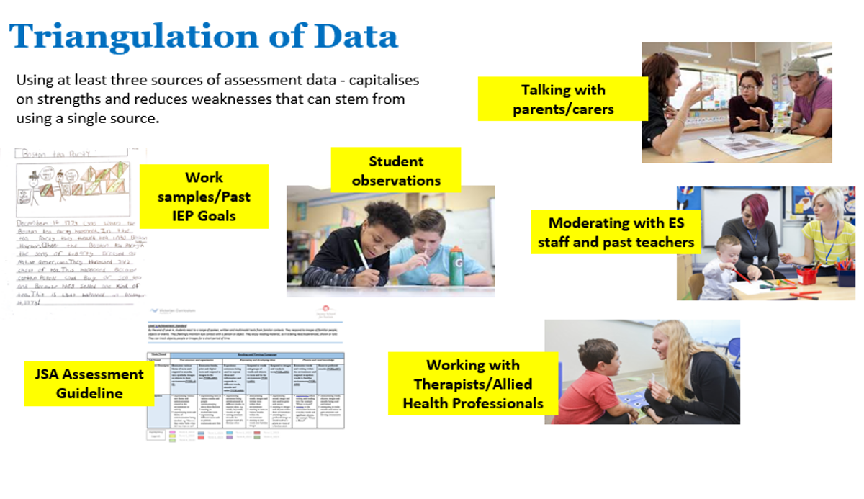
Assessment: key to inform your judgements
JSA Assessment Schedule

Slide 14
Formal Assessment: suggested tools and expectations
FORMAL ASSESSMENTS
ASSESSMENT
Evidence that informs us how our students engaging and working towards attaining their IEP goals
CLASSROOM TEACHERS
Refer to the R&V and N&A Guides to select at least 1 literacy and 1 numeracy tool suitable to each of your students
SPECIALIST TEACHERS
Use your tailored Assessment Rubric for each specialist area to monitor your students’ incremental IEP progress

Slide 15
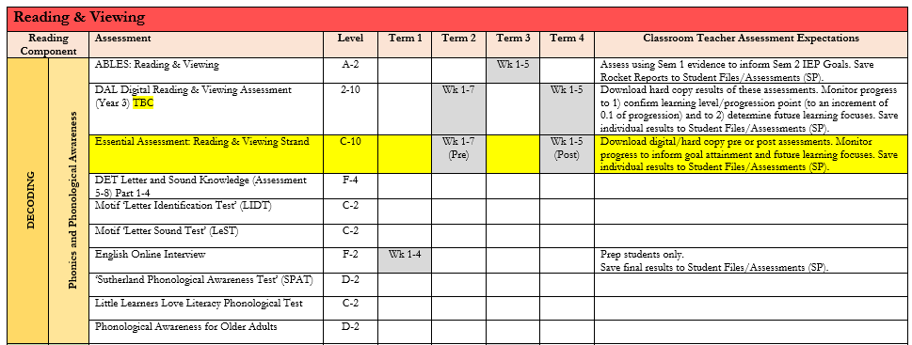
Formal Assessment: Reading and Viewing
Select 1 formal Reading assessment tool to use and assess each student

Slide 16
Formal Assessment: Writing
Select 1-2 formal Writing assessment tools to use and assess each student

Slide 17
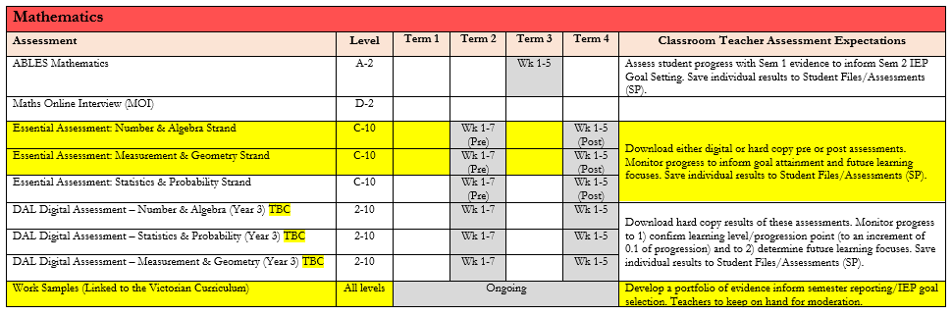
Formal Assessment: Numeracy
Select 1 formal ‘numeracy assessment tool’ to use and assess each student

Slide 18
Assessment Data:
Student A (@ Level C)
READING & VIEWING Goal: Exploring differences between letters by shape and size (VCELA076) | NUMERACY Goal: Identify groups as being ‘one’, ‘more’’ or ‘less’ (VCNMA036)
Motif Letter ID Test | Essential Assessment Level C Addition/Subtraction ‘Post Test’
Photos/Video Observation Notes Therapy Observation Notes | Work Samples Photos/Video Observation Notes
FORMAL
INFORMAL

Slide 19
Assessment Data:
Student B (@ Foundations-2)
READING & VIEWING Goal: Exploring differences between letters by shape and size (VCELA076) | NUMERACY Goal: Identify groups as being ‘one’, ‘more’’ or ‘less’ (VCNMA036)
PM Benchmark Running Record Assessment | Maths Online Interview Sem 1 2023 ‘Addition/Subtraction Test’ (Insight Assessment Platform)
Photos/Video Observation Notes | Work Samples Photos/Video Observation Notes
FORMAL
INFORMAL

Slide 20
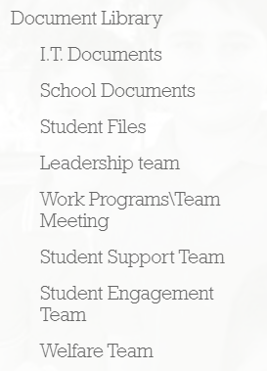
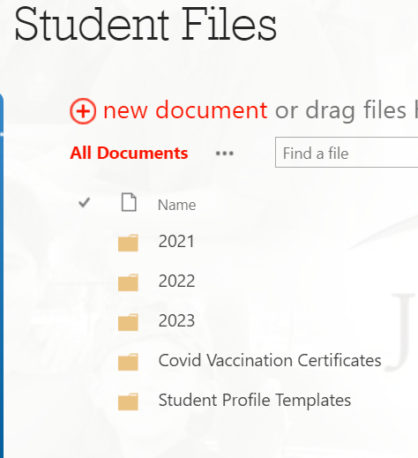
Assessment Data:
Storage on SharePoint

Slide 21
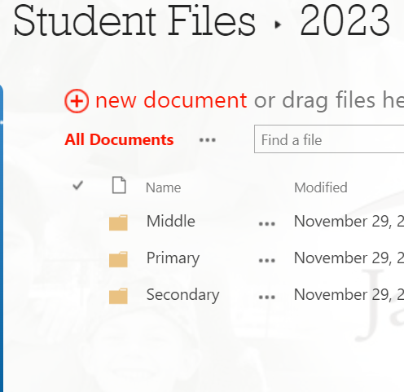
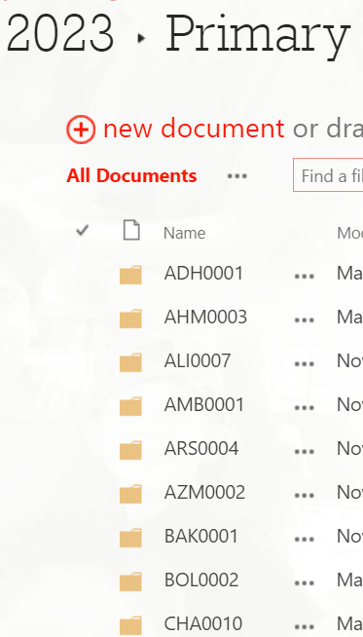
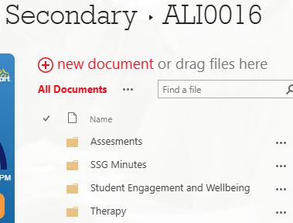
Assessment Data:
Storage on SharePoint
Select the appropriate sub school
Locate each students folder using their Cases Code
Save all assessments in their ABLES Assessment Folder

Slide 22
DRAFT Reports
Learning Area Comments
MS Word format
150-word limit per learning goal

Slide 23
Report Writing - Comments
The comments for each Learning Area can include:
How has the student demonstrated their learning?
The prompt level being used?
What supports are being used?

Slide 24
Report Writing - Comments
Conclude by advising parents/carers:
Outline small incremental skills that the student is working towards.
Outline the suggested focus for 2026.
Remember:
Write comments using a strengths-based approach.
Incorporate student interests and motivators.
List examples of preferred songs, books and programs that they best engage with in their learning.

Slide 25
Sample Report Comments for our
Classroom Teachers

Slide 26
SAMPLE English IEP Goals
English – Speaking & Listening
Student X will blend sounds to produce familiar single syllable words and identify words that have the same rime (VCELA134)
English – Reading & Viewing
Student X will identify some of the features of text such as digital/screen layout or the features of a book cover (VCELA107)
English – Writing
Student X will use, communicate or articulate high-frequency words and reproduce familiar sounds and their letters (VCELA122)

Slide 27
Sample of English Comments
Overall Comment Sample
Reading and Viewing Goal (Literacy)
In Reading & Viewing, Student X has participated in whole class and small group literacy sessions using Colourful Semantics. (He/She/They) has/have been focusing on developing (his/her/their) ability to provide a simple description of an event that has occurred in a book that either the teacher or (he/she/they) has/have read. Student X is encouraged to respond to guided questions using (his/her/their) communication book and completes reading comprehension activities that involve sequencing images from a book and labelling ‘who’ was in the story.
Writing Goal (Literacy)
In Writing, Student X is connecting the skills (he/she/they) has/have developed in Speaking and Listening and Reading and Viewing activities to written activities. (He/She/They) choose/s between two symbols and match the correct symbol to label the ‘who’ in an image. Working one on one with a staff member, Student X is able to write the word that accompanies the symbol.
Speaking & Listening Goal
In Speaking & Listening, Student X is learning to use a few words/images to make a comment about an image or event to expand (his/her/their) vocabulary and the reasons why (he/she/they) communicate/s. (He/She/They) engages in focused activities where (he/she/they) is/are encouraged to explore and respond to photos from class activities, pictures and images from texts.

Slide 28
Sample of Mathematics IEP Goals
Maths – Algebra
Student X will visualise a group of objects as a unit and use this to calculate the number of objects in several identical groups. (VCMNA108)
Maths – Measurement
Student X will collect and display data in response to a question using materials (VCMSP067)

Slide 29
Sample of Mathematics Comments
Overall Comment Sample
Algebra Goal
In Number & Algebra, Student X has demonstrated the ability to count, sort, match and add collections of coins. She/He/They have completed activities that involve using Australian money in practical situations. For example, Student X has exchanged money in play shopping for (use examples from classroom). Student X has been supported by (prompt level as labelled in IEP) and can demonstrate these skills always/sometimes/often (depending on the frequency labelled in IEP).
Measurement Goal
In Statistics & Probability, Student X has engaged in activities ranging from responding to questions from peers, collecting data and asking questions, using the appropriate tool such as tally charts, graphing and tables and observing events in daily lives. She/He/They have completed activities that involve making choices, creating questions for peers, interpreting graphs and sorting and creating graphs. Student X has been supported by (prompt level as labelled in IEP) and can demonstrate these skills always/sometimes/often (depending on the frequency labelled in IEP).

Slide 30
Personal and Social Capabilities
Social Awareness and Management: Relationships and Diversity
Victorian Curriculum Content Descriptors- Levels A-4
Level A: Develop ability to focus attention on others and acknowledge their presence (VCPSCSO057)
Level B: Demonstrate some simple social skills including attending to others, greeting, and following adult directions (VCPSCSO064)
Level C: Follow basic social rules regarding the sharing and care of property and social expectations regarding behaviour (VCPSCSO071)
Level D: Respond to others in group situations, playing or working in a small group cooperatively (VCPSCSO078)
Foundations: Name and practise basic skills required to work collaboratively with peers (VCPSCSO006)
Level 1-2: Use basic skills required for participation in group tasks and respond to simple questions about their contribution to group tasks (VCPSCO014)
Level 3-4: Demonstrate skills for effective participation in group tasks and use criteria provided to reflect on the effectiveness of the teams in which they participate (VCPSCSO023)

Slide 31
Personal and Social Capabilities
Self-Awareness and Management: Development of Resilience
Victorian Curriculum Content Descriptors- Levels A-4
Level A: React to people and express emotions (VCPSCSE052)
Level B: Respond to people or events and demonstrate a range of emotions (VCPSCSE059)
Level C: Name emotions shown by self and match these emotions to familiar events or experiences (VCPSCSE066)
Level D: Name a range of emotions and describe how these are expressed or shown (VCPSCSE073)
Foundations: Develop a vocabulary and practise the expression of emotions to describe how they feel in different familiar situations (VCPSCSE001)
Level 1-2: Extend their vocabulary through which to recognise and describe emotions and when, how and with who, it is appropriate to share emotions (VCPSCSE008)
Level 3-4: Identify and explore the expression of emotions in social situations and the impact on self and others (VCOSCE016)

Slide 32
Sample of PSC Comments
Overall Comment Sample
Self-Awareness & Management Goal
In developing his self-awareness, Student X has been focusing on recognising that problems or challenges are a normal part of life and that there are actions that can be undertaken to manage these problems. He/She/They has/have been identifying skills such as asking for help in the playground, identifying friends to play with, discussing challenges with staff and other help seeking skills to improve his ability to solve issues in a timely manner. Student X can identify members of staff in his/her/their classroom and in the playground that he/she/they can talk to for support. He/She/They require/s some support from classroom staff to work through social problems. Student X will continue to work on this goal so that he/she/they becomes more independent and applies his/her/their problem-solving skills to other situations.
Social-Awareness & Management Goal
In developing his social-awareness, Student X is learning to respond to others in group situations and playing or working in a small group cooperatively. He/She/They is/are participating in activities that encourages participation in group activities, to co-operate with adults and to learn to co-operate with peers. Student X need verbal prompting to remember to listen to others, take turns, share items and to be respectful of others. He/She/They is/are encouraged to play games with his peers and to complete work tasks in small group settings to further develop his skills. Student X will continue to work on both these goals in semester two to develop his Personal and Social Capabilities skills.

Slide 33
Science IEP Goal
All Humanities goals need to be uploaded onto Accelerus
Suggested IEP Goals are attached

Slide 34
Semester 2 Science IEP Goals
Term 3 Science Unit: ‘Biology’
Victorian Curriculum Content Descriptors- Levels A-4
Level A: Objects are part of the world around us. (VCSSU003)
Level B: Objects can be the same or different and can look and feel different. (VCSSU013)
Level C: Objects have different names and properties, and some can be manipulated and changed. (VCSSU023)
Level D: Objects can be sorted into groups based on their properties, and some objects can be mixed and changed. (VCSSU033)
Foundations-Level 2: Objects are made of materials that have observable properties. (VCSSU044)
Level 3-4: Natural and processed materials have a range of physical properties; these properties can influence their use. (VCSSU060)
To be updated 2025

Slide 35
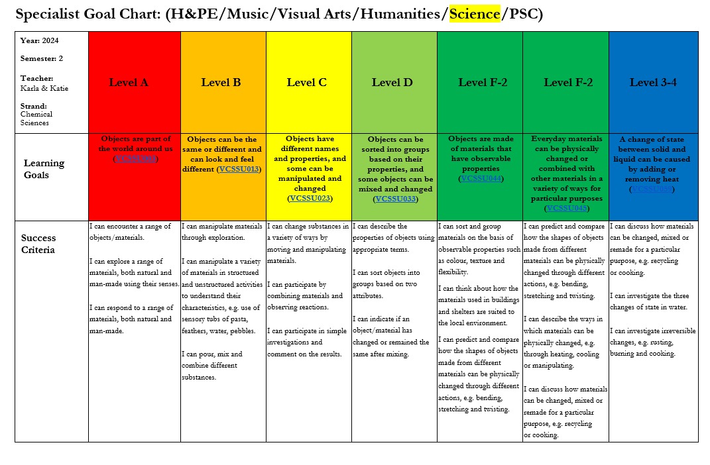
Semester 2 Science IEP Goals
The 3 Success Criteria for each learning goal can be uploaded to Accelerus and assessed upon for each report.
Please access these via Google Drive.
To be updated 2025

Slide 36
Home Comment
All students require a general, overall comment within their report
Include detail regarding:
  Special Successes
  Readiness to learn
  Calming strategies
  Friendships, working partnerships with staff
  Additional programs, including excursions
  Classroom and schoolwide leadership roles
  Key areas to work on next semester

Slide 37
Home Comment Sample
In Semester 2, Student X has demonstrated increasing independence in his/her/their time at JSA both developing routines to settling into his/her/their new class and engaging in learning all aspects of his/her/their IEP goals. He/She/They approach/es school time positively in Room XX and looks to develop and extend his/her/their knowledge whenever he/she/they can.
Student X has shown a keen interest across each of the key learning areas and is actively involved in Health & PE, Music and Art classes. He/She/They has also been a keen participant and leader in our student leadership program/school recycling program or other.
Student X enjoyed parking a in a range of incursions and excursions as part of our annual calendar. He/She/They took part in our swimming program at the Book Week Dress Up Day, our House Colours Disco, our Footy Day and importantly remembering those soldiers who fought our country during Remembrance Day.
We are pleased to see a range of improvements and growing independence in Student X’s learning and time at school this semester. In 2024, we hope to further consolidate his/her/their broader knowledge and skills in preparation for a great list of achievements and memories shared in the new year. Well done on a great year’s work, Student X!

Slide 38
Sample Report Comments for our
VPC teachers

Slide 39
Sample VPC Report Comments
VPC teachers report on the following areas
Literacy
Numeracy
Personal Developmental Skills
Work Related Skills
Each outcome taught is assessed at the mid-year and end-of-year stage.
Outcomes are assessed along a 5-point scale, as below:
NOTE: Aside from reporting upon the 4 VPC modules, teachers also need to report on/provide:
Science
Home Comments

Slide 40
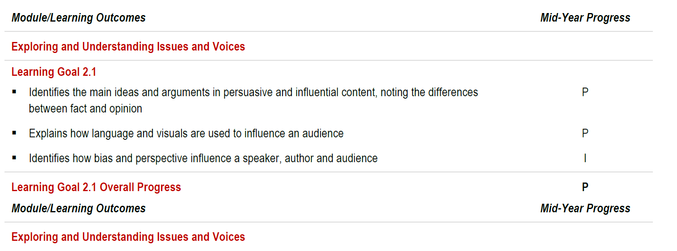
Sample VPC Report Comments
This Semester 1 VPC sample is indicates the student is working towards completion of the Learning Goal 2.1 within Unit 2 of Literacy.
100-200 words are written per sub-component of this learning goal ONLY.
Throughout the semester, Tarek has been involved in exploring the issues around our school and in the community. He participated in discussions investigating “School Phone Policy” and “Social Media Usage Amongst Teens”. As a class he independently discussed the pros and cons of the Phone Policy and Social Media and how it affected students and their mental health. Tarek shared his ideas on the phone ban at school and was in support of the School Phone Policy and suggested that phones should be locked away as it distracted students. He further used a graphic organizer template to draft a persuasive text on Phone ban at school.
Tarek was involved in discussing other issues impacting students at school such as, “Should package food be banned at school?”, “Should students wear school uniform?” etc. Tarek, with minimal support, identified the issue, the main idea of the topic and three supporting details to support his statement. Using a graphic organizer template, he independently created a short persuasive text on the above stated topics.
While reading a persuasive text, he independently highlighted the facts, opinions and arguments suggested in the given text. Tarek showed his understanding of the persuasive language which is inclusive in nature and uses pronouns such as us, we, ours etc. to convince people and to change their perception as in debates or advertisements.
Tarek has been learning about Author’s Bias and Perspective and how that can influence the audience. He was engaged in reading a variety of persuasive texts such as articles on healthy food, First Nations people, social media etc. Tarek participated in Informed discussions where he shared his point of view and how his point of view was different from the author’s point of view.

Slide 41
Sample Report Comments for our
Specialist Teachers

Slide 42
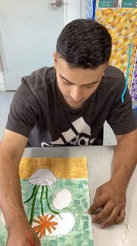
Visual Arts IEP Goals
Specialist teachers are required to upload comments for all Visual Art goals onto Accelerus
Suggested IEP goals are attached

Slide 43
Semester 2 Visual Arts IEP Goals
Visual Arts – Explore & Express Ideas
Level A: Experience creation of visual artworks (VCAVAE001)
Level B: Explore materials to create visual artworks (VCAVAE005)
Level C: Explore experiences and observations to create visual artworks (VCAVAE009)
Level D: Explore ideas, experiences and observations to create visual artworks (VCAVAE013)
Level F: Explore ideas, experiences, observations and imagination to create visual artworks (VCAVAE017)
Level 1-2: Explore ideas, experiences, observations and imagination and express them through subject matter in visual artworks they create (VCAVAE021)
Level 3-4: Explore ideas and artworks from different cultures and times as inspiration to create visual artworks (VCAVAE025)
To be updated 2025

Slide 44
Suggested Comment: Visual Arts
As per any curriculum area, we simply need a Visual Arts goal progress summary of 100-200 words ONLY.
As with Semester 1, Arnya will provide samples for Primary/Middle teachers to access.
Visual Arts Goal Comments
Student X explored (his/her/their) understanding of the themes and concepts delivered in each session. (He/She/They) observed and responded to hand-over-hand prompting, teaching and student modelling to participate in class discussions and projects. Student X attempted ways to use different materials and techniques such as painting, object rubbing, collage and drawing, and applied these and (his/her/they) ideas into artworks.
This semester, Student X made costumes and props for the School Performance using recycled materials as we explored the cross-curriculum theme with science. (He/She/They) enjoyed this hands-on, creative experience. Student X developed an art appreciation of Indigenous Aboriginal Culture, learning about the symbols, patterns and icons used to express significant meaning through art making. Used mixed media to create landscapes of significant places in Australia. (He/She/They) created a range of art works such as honeycomb tessellations, safari prints and the textures of trees, using natural materials to reflect how there are visible patterns in nature. Student X, congratulations on your achievements in Visual Arts this semester!

Slide 45

Music and Dance IEP Goals
Specialist teachers are required to upload comments for all Visual Art goals onto Accelerus
Suggested IEP goals are attached

Slide 46
Semester 2 Music IEP Goals
‘NAtive Plants and Animals’ and ‘Cause and Effect’ Unit Focuses
Music – Respond and Interpret
Level A - Be involved in music performances (VCAMUP003)
Level B - Perform music to express a given idea (VCAMUP007)
Level C - Perform a short piece of music they have learnt (VCAMUP011)
Level D - Perform a piece of music they have learnt or perform a piece of music to communicate an idea (VCAMUP015)
Foundations - Rehearse and perform songs and short instrumental pieces which they have learnt and composed (VCAMUP019)
Level 1/2 - Rehearse and perform songs and instrumental music they have learnt and composed to communicate ideas to an audience (VCAMUP023)
Level 3/4 - Rehearse and perform songs and instrumental music they have learnt and composed, shaping elements of music to communicate ideas to an audience (VCAMUP027)
To be updated 2025

Slide 47
Suggested Comment:
Music and Dance
Visual Arts Goal
In music activities, (Student X) made attempts to imitate simple patterns in sound made by another, and/or make simple patterns in sounds intentionally and/or interact through imitating others’ sounds or by recognising self being imitated, e.g. joining in rhythm play alongs with peers. (He/She/They) was encouraged to participate in activities where (he/she/they) used music to express and communicate experiences, observations, ideas and feelings about themselves and their world e.g. using microphone, seeing music, rumbles, making up games/songs. When needing support to engage, (he/she/they) requested movement or other quiet activities to observe when music was taught. Great work, (Student X)!
As per any curriculum area, we simply need a Music goal progress summary of 100-200 words ONLY.

Slide 48

Health & PE Goals
Specialist teachers are required to upload comments for all Visual Art goals onto Accelerus
Suggested goals are attached

Slide 49
Semester 2
Health & PE IEP Goals
Health
'Safety’
Level A: React to people and sensory experiences (VCHPEP004)
Level B: Practise basic skills of personal care and communicate basic needs, likes and dislikes and experience the social skills of turn taking and sharing (VCHPEP018)
Level C: Practise personal hygiene, independence skills and social skills including taking turns (VCHPEP032)
Level D: Practise personal skills of self-care, hygiene and independence and practise social skills to interact with others (VCHPEP046)
Foundations: Practise personal and social skills to interact with others (VCHPEP060)
Level 1-2: Identify and practise emotional responses that account for own and others’ feelings (VCHPEP076)
Level 3-4: Describe factors that can positively influence relationships and personal wellbeing (VCHPEP092)
To be updated 2025

Slide 50
Semester 2
Health & PE IEP Goals
'Active Play & Minor Games’
Movement and Physical Activity
Level A: Experience regular physical activities and begin to develop an awareness of how different parts of the body move (VCHPEM010)
Level B: Engage in regular physical activities and explore the development of their ability (VCHPEM024)
Level C: Engage in regular physical activities and explore the development of their ability and health (VCHPEM038)
Level D: Explore how regular physical activity keeps them healthy and well (VCHPEM052)
Foundations: Explore how regular physical activity keeps individuals healthy and well (VCHPEM066)
Level 1-2: Discuss the body’s reactions to participating in physical activities (VCHPEM083)
Level 3-4: Examine the benefits of physical activity and physical fitness to health and wellbeing (VCHPEM100)
To be updated 2025

Slide 51
Suggested Comment:
Health & PE
Health Goal:
To be confirmed
Movement & Physical Activity Goal:
Student X participated in these sessions, leading and following his peers successfully, with a high level of adult support. He/She/They participated in indoor yoga sessions in the classroom to model how to calm and regulate the body. These sessions each week helped him/her/them to refine certain exercises to stretch and relax muscles in a group situation with their peers. Student X was supported to take part in outdoor ball games including cricket, tennis, football and soccer. He/She/They learned to use the sports equipment safely and work towards playing as part of a team. Great work this semester, Student X!
As per any curriculum area, we simply need a goal progress summary for each goal of 100-200 words ONLY.

Slide 52
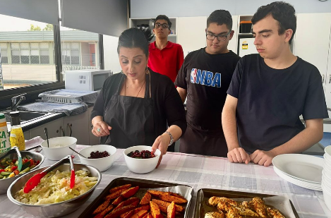
Technologies IEP Goals
(Café)
For either HOL Café, our designated HOL teachers are required to upload all Technologies goals onto Accelerus
Suggested IEP goals are attached

Slide 53
Semester 2
Technologies (Cafe) IEP Goals
HOL Café ‘Design and Technologies (Technologies Contexts)’ IEP Goals
‘Consolidating and Extending Skills and Techniques’
Level A: Experience the characteristics and properties of familiar designed solutions in at least one technologies context (VCDSTC002)
Level B: Explore the characteristics and properties of familiar designed solutions in at least one technologies context (VCDSTC005)
Level C: Examine and indicate the characteristics and properties of familiar designed solutions in at least two technologies contexts (VCDSTC008)
Level D: Explore and communicate the characteristics and properties of familiar designed solutions in at least two technologies contexts (VCDSTC011)

Slide 54
Semester 1
Technologies (Cafe) IEP Goals
HOL Café ‘Design and Technologies (Technologies Contexts)’ IEP Goals
‘Consolidating and Extending Skills and Techniques’
Level F-2: Explore how food is selected and prepared for healthy eating (VCDSTC016)
Level 3-4: Investigate food preparation techniques used in modern or traditional societies (VCDSTC026)
Level 5-6: Investigate the role of food preparation in maintaining good health and the importance of food safety and hygiene (VCDSTC036)
Level 7-8: Analyse how characteristics and properties of food determine preparation techniques and presentation when creating solutions for healthy eating (VCDSTC047)
Level 9-10: Investigate and make judgements on how the principles of food safety, preservation, preparation, presentation and sensory perceptions influence the creation of food solutions for healthy eating (VCDSTC058)

Slide 55
Suggested Comment:
Technologies (Café)
Technologies Goal:
This semester, Student X worked on and developed the basic skills and knowledge to prepare and produce a range of recipes for items on offer in our JSA Canteen each week. He/She/They produced a range of food items such as salads, wraps, yogurt cups and more. Student X worked well with others to wear the correct clothing, safely use the appropriate equipment and follow set recipes with prompts to produce food items to a presentable standard. Great work, Student X!
As per any curriculum area, we simply need a Technologies goal progress summary of 100-200 words ONLY.

Slide 56
Special Consideration
Please refer to the JSA Reporting Guidelines to adapt your semester reports for students with the following circumstances:
Dual Placement (Reduced Time Fraction)
Engagement Plan
Outstanding Absence
We ask that you negotiate with Ellen or Dan to establish a realistic set of IEP goals to report upon given their level of attendance.
*NB If students have not attended for a reasonable length of time, an IEP goal is then switched off thus not referred to for the semester. Set reporting comments for these students are to be used, as built into the above guidelines.

Slide 57
JSA Reporting Guidelines – Grammatical Tips
Student Names: when setting IEP goals and formally reporting, all students should be referred to by their formal names outlined in our Cases student lists rather than by their preferred names used in person.
Names/Pronouns: Alternate the use of name and pronoun to avoid repetition, e.g., John is a happy, energetic student who actively participates in class discussions. He/She/They responds well to feedback and approaches tasks with a positive attitude. John works co-operatively with her classmates and usually completes work in the designated time. Note, that the appropriate use of pronouns is in alignment with the intentions formally agreed between both the classroom teacher and the parent, confirmed in writing.
Notes:
mention pronouns - not over doing gender neutral pronouns

Slide 58
JSA Reporting Guidelines – Grammatical Tips
Capitalisation: to ensure consistency, capitals are to be used for subject areas or sub strands e.g., Mathematics, Health & Physical Education or Reading & Viewing and when stating a specific term or semester e.g., ‘Term 1’ and ‘Semester 1’.
Non-Capitalisation: avoid capital letters for examples such as ‘friends of ten’ or related language such as ‘finding the main idea’ and ‘text to self’’, rather put in inverted commas as illustrated above.
Use of numbers: to ensure consistency, numbers are to be used when providing examples of number sentences or measurements in mathematics e.g., 3+3=6, 4cm or when articulating time periods, such Week 8, Term 1 and Semester 2. Number words are not to be used.

Slide 59
JSA Reporting Guidelines – Grammatical Tips
Use an ‘anthers and’ symbol (&) for denoting ‘and’ in titles or when embedded within comments, in reference to our curriculum strands and sub strands e.g., as for:
  English: Reading & Viewing, Speaking & Listening,
  Mathematics: Number & Algebra, Statistics & Probability,
  Personal & Social Capabilities: Self-Awareness & Management and Social Awareness & Management
  Health & Physical Education: Personal, Social & Community Health and Movement & Physical Activity
  Visual Arts: Explore & Express Ideas
Focussed or Focused
For consistency, we will spell focused with the one ‘s’.

Slide 60
JSA Reporting Guidelines – Grammatical Tips
Practice v Practise
PRACTICE: is a noun.
e.g. handballing practice
Like other skill development, intercultural skills are acquired through practice.
Try using the word preparation (or lessons) instead of practice. If the sentence still makes sense, then practice is almost certainly correct. (This trick works because practice is a noun, just like the words preparation and lessons.)
PRACTISE: is a verb
e.g. Student X needs to practise his/her/their letter formation.
Student X needs to practise her 8 times tables facts.
Try using the verb to prepare (in its various forms, e.g., preparing, prepared, prepares) instead of practise. If the sentence still makes sense, then practise is almost certainly correct. However, if you find yourself trying to use preparation, then you should be using practice, because both are nouns. (This trick works because to practise is a verb, just like to prepare.)

Slide 61
Semester 2 Reporting Classroom Teacher Buddies
Primary | Middle | Secondary | Specialists
Rachael - Will | Jeanette - Fatima | Nelly - Pauline | Emma - Darren
Calvin - Sam | Shirley - Ange | John/Suzanne - Angela | Karla - Ira
Karen/Oledia - Anita | Peter - Ruby | Carmel - Fiona - Evie | Deb - Stephanie
Sarah - Santhy - Leona | Jen - Stephanie - Paris | Gurminder - Juri/Sadie | HPE (TBC) Katie - Arnya

Slide 62

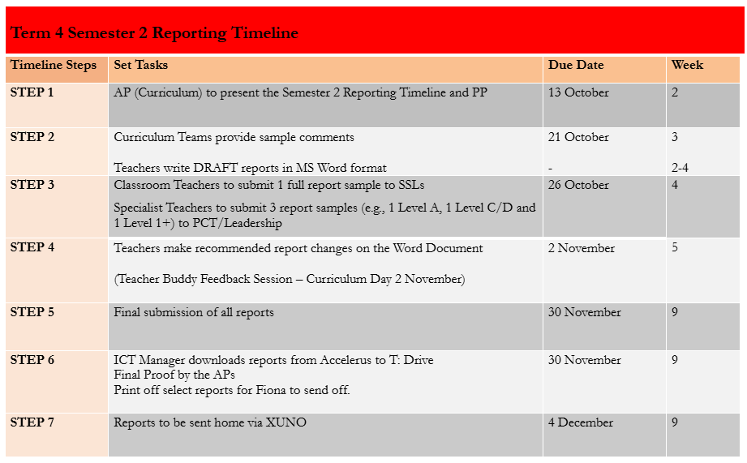
Semester 2 Reporting Timeline

Slide 63
Student Support Group Meetings
SSGs Meetings
DE Policy: all students MUST have a minuted SSG every term
Recording of SSG minutes saved into Student Files
Legal Document
Term 3 week 9 audit

Slide 64
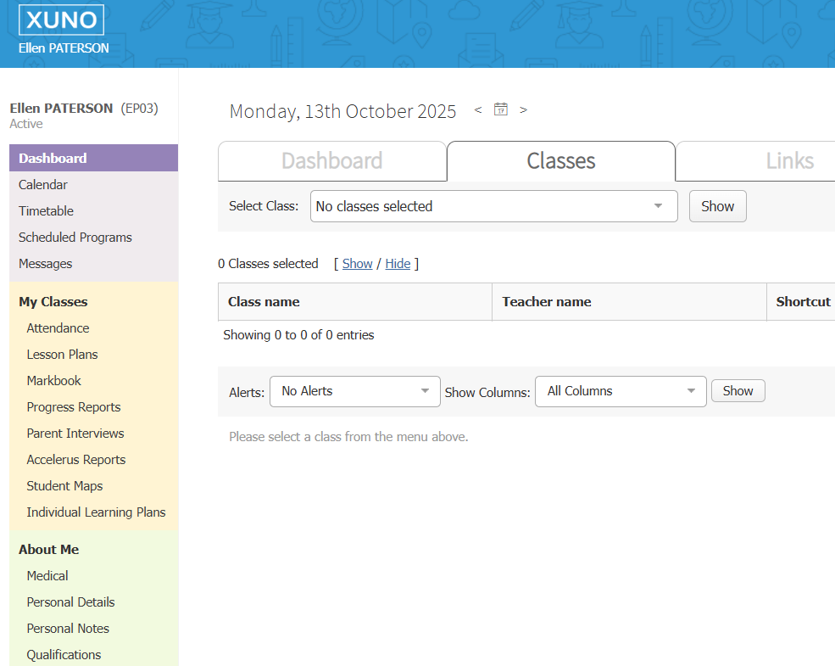
Student Support Group Meetings
Term 4 - Booking on XUNO

Slide 65

Thank you, everyone!

