Slide 1
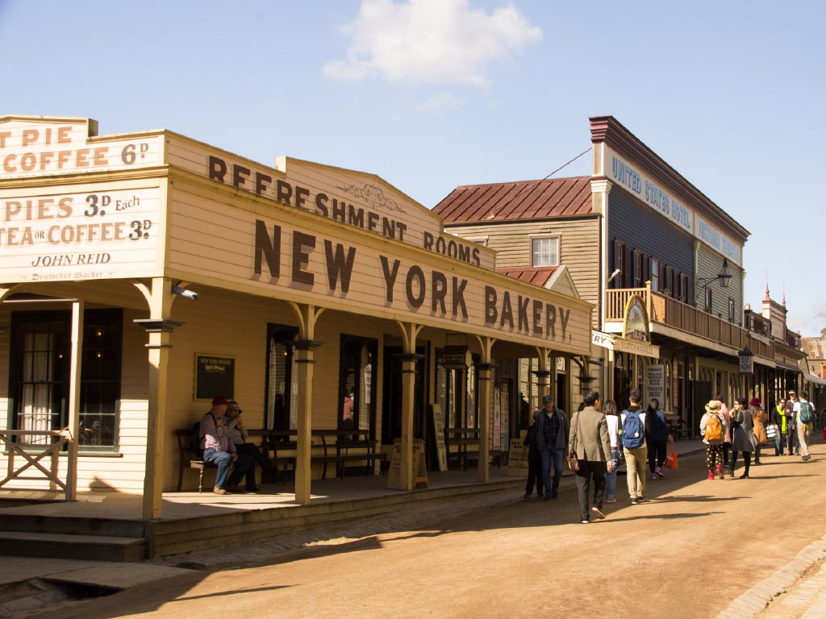
Year 5/6 CAMP
SOVEREIGN HILL, Ballarat 2021

Slide 2
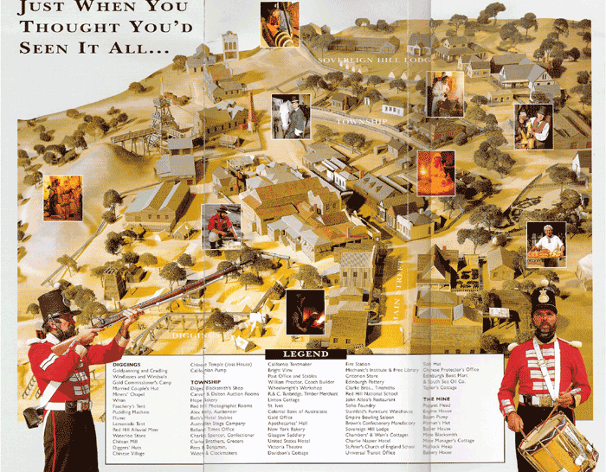
SOVEREIGN HILL MAP

Slide 3
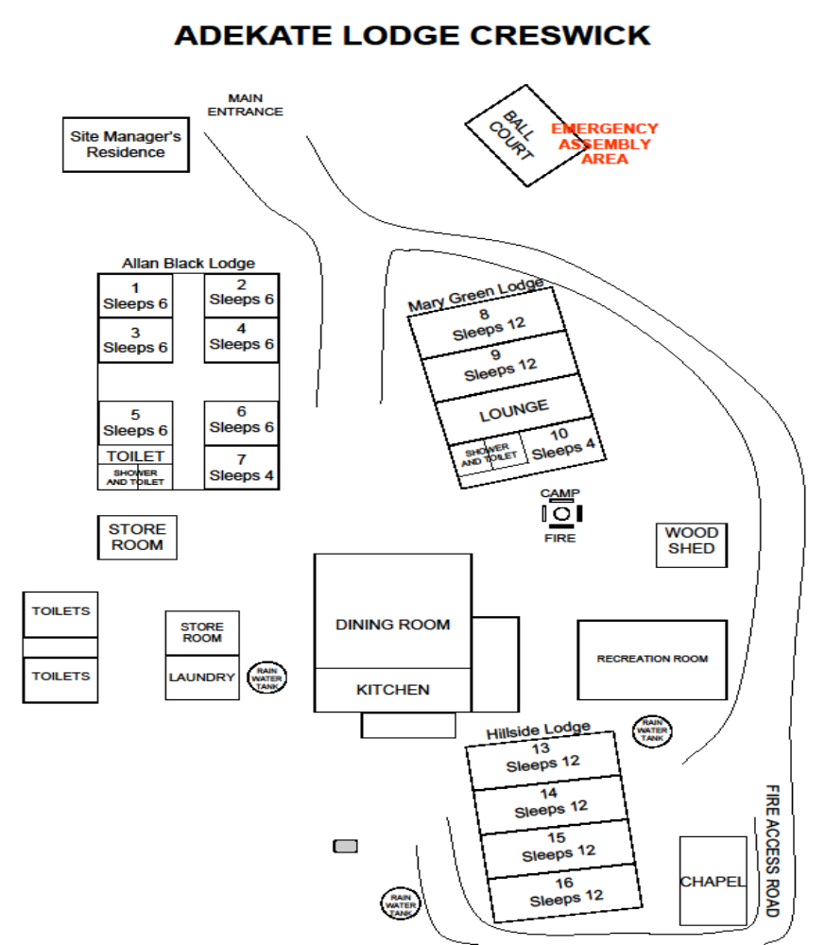
Camp Adekate Map
Upwey South Primary School is the only school attending camp during this week. There for we are able to complete all activities within our school ‘bubble’.
We are utilising the Alan Black Lodge and Mary Green Lodge for our accommodation.
If the weather is kind to us, meals will be served outdoors.
This map does not show where the onsite activities are completed.

Slide 4
CAMP ITINERARY
Monday 29th November:
Depart school (9.30am), arrive at Adekate Lodge camp. Students eat lunch (brought from home)
Afternoon activities on site.
Dinner at camp.
Evening activities onsite.
Tuesday 30th November:
Sovereign Hill Day excursion (10.00am – 5.00pm)
Students will participate in an underground mine tour, gold pouring demonstration, and an educational session. Topic is GOLD FEVER – links to living on the gold fields and the troopers
Dinner at camp.
Evening activities onsite
Wednesday 1st December:
Pack up Camp in the morning
Complete the Amazing Race – onsite camp activity
Depart Camp 1.00pm
Arrive at school around 3.00pm (arrival time TBC via Compass)

Slide 5
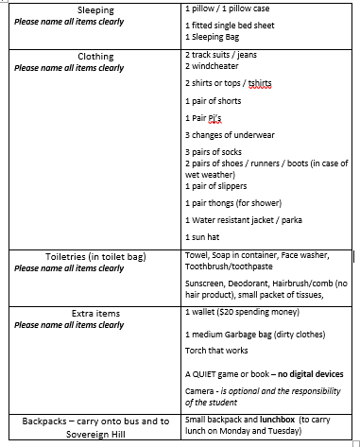
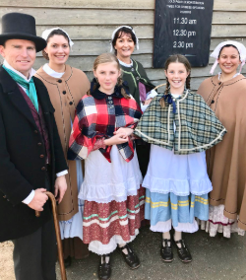
Clothing List
1 Sleeping Bag

Slide 6
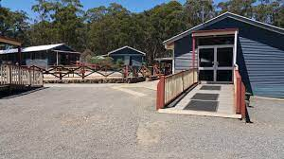
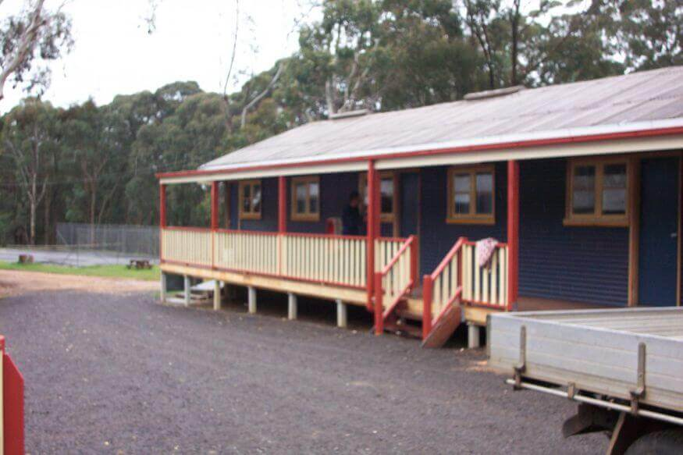
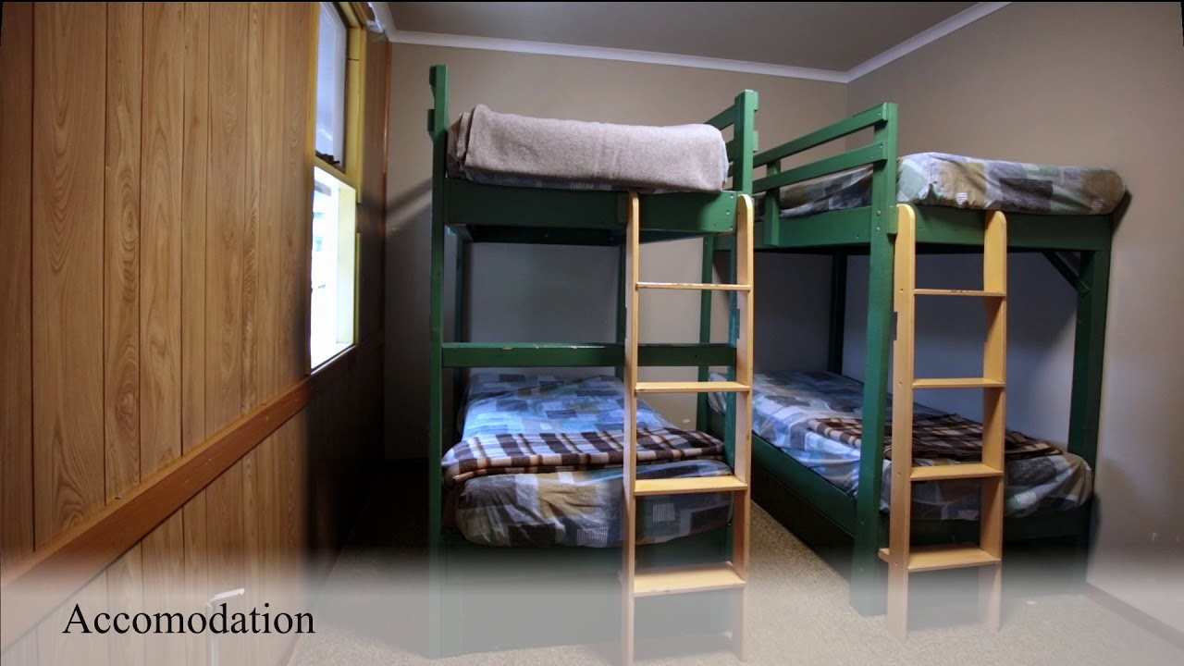
Accommodation – Adekate Lodge
Youtube : UCC Adekate Site visit: https://www.youtube.com/watch?v=KX3zBMjTZK4&t=19s

Slide 7
Questions Linked to Camp
Are there additional medical/dietary/family details that the school will need to collect beyond those which are already in Compass?
Yes, Medical forms went home on Tuesday. Many of our students have already brought them back, if you haven’t can this be done tonight.
Will the Parent/Carer Information Session be recorded?
No, we will not be recording the session as we do not wish to capture images of family members. We will however be sharing and distributing all resources, Q &A’s, etc. which are referred to during the session. These notes plus any extra questiosn will be sent out on Friday via Compass
Will students get a temperature check on the morning of camp?
No, it is not a requirement for students to be temperature checked before a school activity. A thermometer will be taken on camp to use if a student becomes unwell. In the case that a student is exhibiting signs of illness we will contact parents/carers to discuss personalised arrangements.
Do students need to wear masks while on the bus?
Yes, ALL students must wear a mask while on the bus as we are in an enclosed space with limited fresh air ventilation. Once we arrive at Camp Adekate, we will continue to follow the regulations set by the Victorian Government.
What will happen if my child gets COVID19 symptoms while on camp?
Should a child be displaying COVID-19 symptoms, they will be monitored, temperature-checked and isolated in a supervised and safe location within the camp setting. These symptoms will be recorded (date and time). Parents/Carers will be contacted and will be required to collect their child from the campsite.
Will I be able to receive a refund if I need to collect my child?
If you are collecting your child from camp due to COVID-19 symptoms, you will be eligible to apply for a pro-rata refund. This refund is only available linked to COVID-19.

Slide 8
LEARNING OUTCOMES OF CAMP
Knowledge of a significant part of Australian History – Gold Rush and Life in the 1850’s
Resilience
Persistence
Teamwork
Communication

Slide 9
Additional Questions asked:

