Slide 1
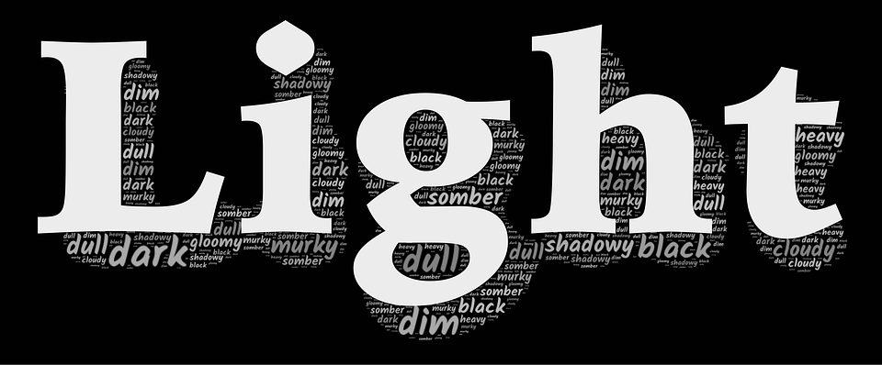
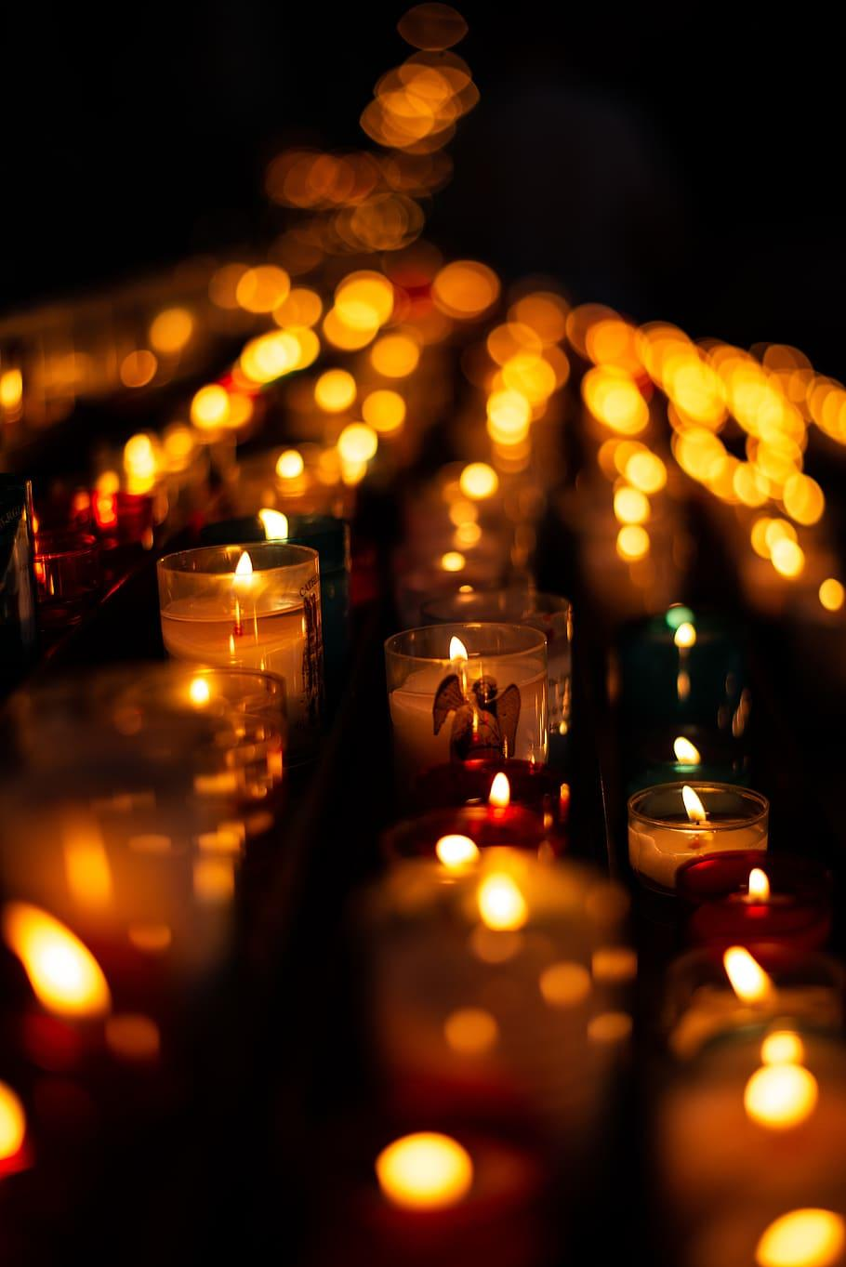
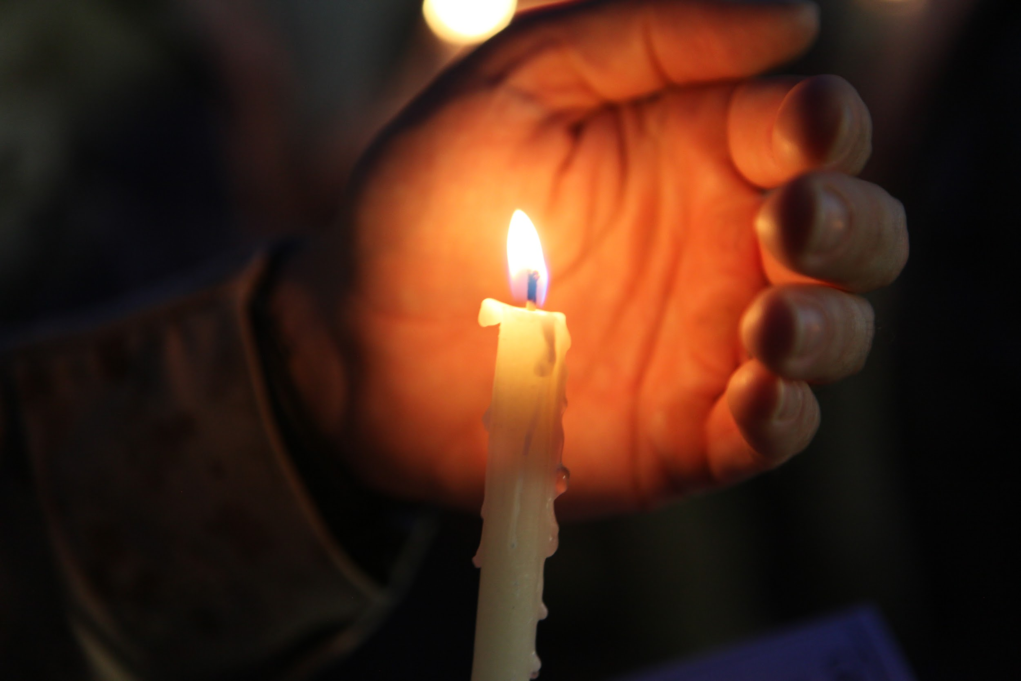
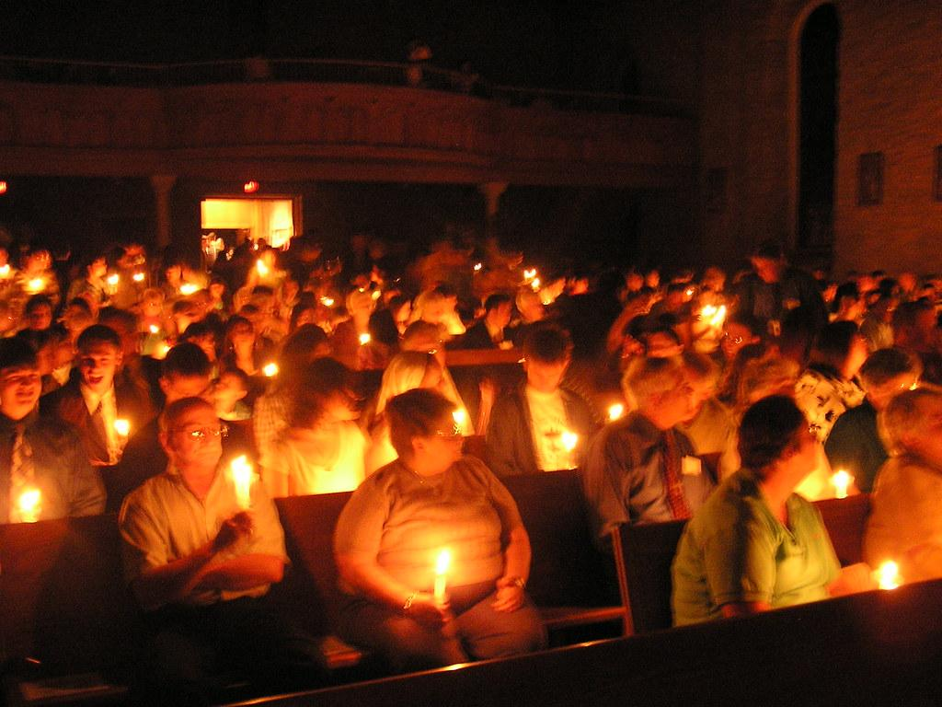
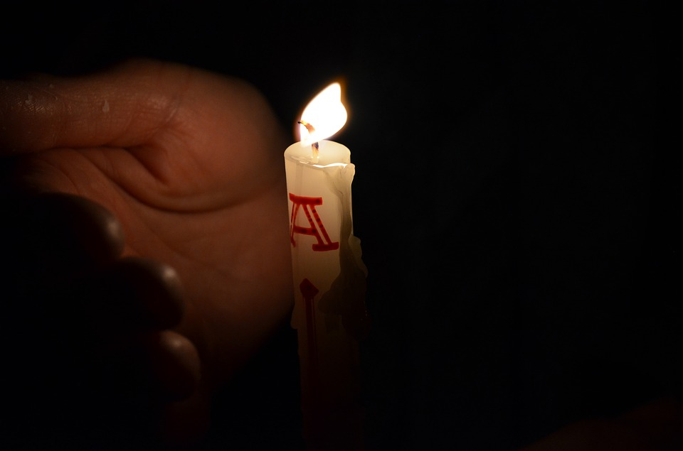
The Easter Vigil - Light

Slide 2
How is light-candle used in the easter vigil ?
At the opening of the Easter Vigil a "new fire" is lit and blessed. ... The Paschal candle is the first candle to be lit with a flame from this sacred fire, representing the light of Christ coming into the world. This represents the risen Christ, as a symbol of light life dispelling darkness death.

Slide 3
What is light in the church ?
In Anglican, Old Catholic and Roman Catholic churches, the chancel lamp burns before a tabernacle or ambry to demonstrate the belief that Christ is present there through His Real Presence, as the Blessed Sacrament is reserved in these denominations.

Slide 4
What does the candle symbolize ?
The Paschal candle is the first candle to be lit with a flame from this sacred fire, representing the light of Christ coming into the world. This represents the risen Christ, as a symbol of light life dispelling darkness death.

Slide 5
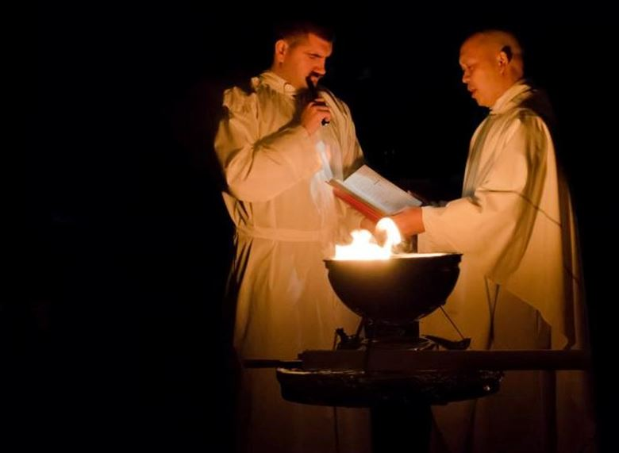
The priests lighting the holy vigil candle.

Slide 6
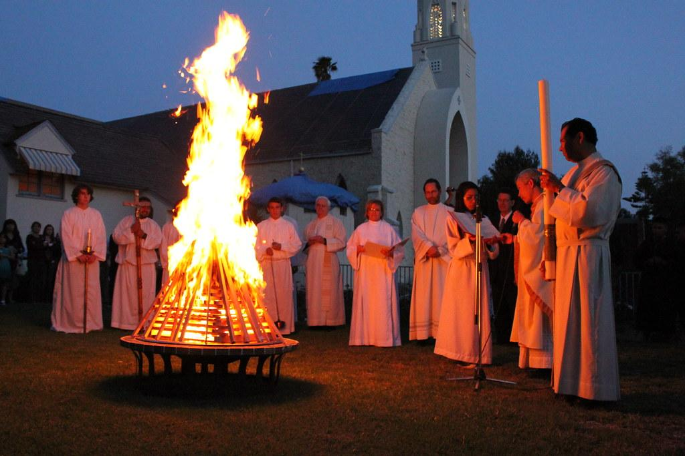
Roughly how many people will come to the mass.

