Slide 1

Learning floats on a sea of talk
Douglas Barnes

Slide 2
Oral Language
Dialogic Classroom
How You Can Support at Home

Slide 3

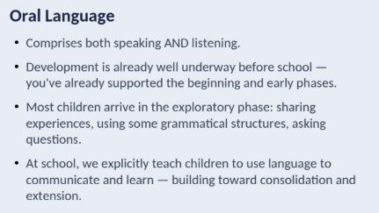

Slide 4
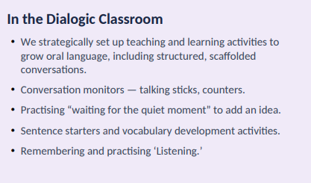

Slide 5
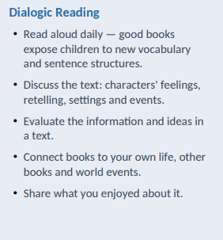
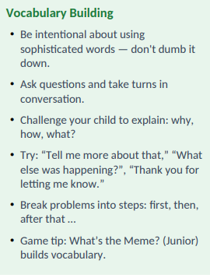
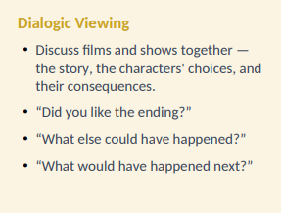
What you can do at home.

Slide 6
Thank you for helping your child become a confident, articulate communicator — at home, at school, and everywhere in between.
References: Britton (1976); Barnes (1976); Chambers (1993).
Also: Please note we acknowledge some of this content was guided by the Marian Nicolazzo’s presentation to the OHR community at the Information night in February.

