Slide 1

Emergency Management
Lockdown and evacuation procedures

Slide 2
Drills and exercises
Why?
Tests the Emergency Management Plan
Makes sure you know what to do in an emergency and reduces your concern if an emergency does occur
Builds confidence
All schools are required to test their emergency management plan

Slide 3

Core Emergency Response Procedures
There are five core emergency response procedures:
1. On-site evacuation (relocation – can be a partial evacuation) – eg building fire in one part of the school
2. Off-site evacuation – eg a bomb threat or large building fire
3. Lock-down – eg an intruder or swarm of bees
4. Lock-out – eg a building has been deemed unsafe for use
5. Shelter-in-place – eg a sudden storm during recess or lunch

Slide 4
Key Points
The aim is to get EVERYONE OUT SAFELY or EVERYONE LOCKED IN SAFELY.
There will be an emergency tone sounded:
*continuous bell for LOCKDOWN
*”whoop whoop” siren for EVACUATION.
LISTEN for instructions. You need to be QUIET once you hear the continuous bell or emergency siren as there will be instructions over the loudspeaker.
Stay calm and follow all instructions.

Slide 5


VIVI SCREEN

Slide 6
What do we do when we hear the evacuate tone (‘whoop, whoop’) in class?
1) Be calm. Be quiet so you and your teacher can listen to the announcements
2) When directed by your teacher, stand quietly behind your chairs, leave all belongings behind
3) Wait for your teacher’s instructions and follow them.
4) Walk quickly and calmly, with your class and teacher, to designated evacuation area. Stay with your class.
5) Line up and follow your teacher’s instruction. DO NOT wander away from the line.
6) If you have your phone with you (and you shouldn’t!!) DO NOT contact parents. This causes them to phone the office and hold up phone lines that may needed for communication with emergency services.

Slide 7
What do we do if we are not in class? (evacuation)
If you are elsewhere in the school (library/bathroom etc) make your way quickly and quietly to the evacuation area and report quickly to your teacher. Stay with your teacher and class.

Slide 8
What do we do when we hear the lock-down (continuous bell) tone in class?
1) Be calm. Be quiet so you and your teacher can listen to the announcements
2) Follow your teacher’s instructions.
3) Depending on the reason for the lockdown, you may be asked to crouch under your desk, or move into the middle of the room, or a building foyer. Respond quickly and quietly.
4) Stay calm and quiet until the tone sounds to end the lockdown.

Slide 9
What to do if you are not in class? (lockdown)
1) If you are in the toilet, move quickly to the nearest classroom. The teacher in that room will notify your teacher that you are with them.
2) If you are in the library, or inclusion, or wellbeing, STAY THERE. Staff will notify your class teacher that you are with them.

Slide 10
How will we know what is happening?
Leadership will be busy initially doing whatever is needed to manage the emergency – ensuring everyone is safe and communicating with emergency services and following any instructions they may give.
As soon as possible, your parents will be notified that the school is in evacuation mode/lockdown.
Your parents will be updated on the situation via SMS/Compass.
Your teachers will be updated on the situation via a dedicated Emergency Teams Channel and SMS and they can relay this information to you.
No information means no change!

Slide 11
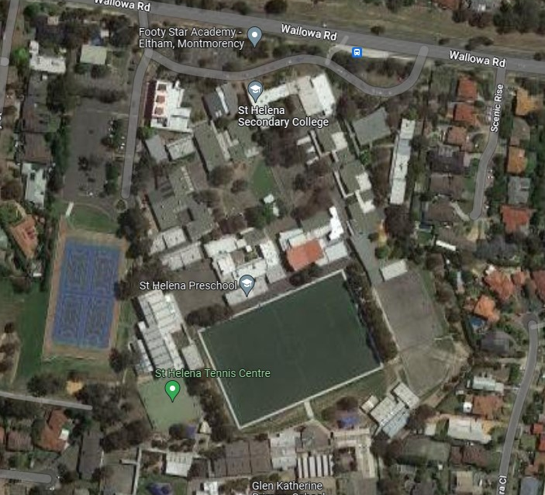
Evacuation Point 1 –Netball courts

Slide 12


Evacuation Point 2 - Oval

