Slide 1
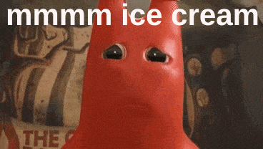
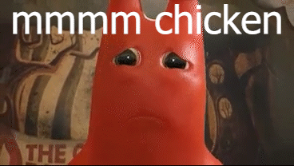
Banbans true form
By cooper guy

Slide 2
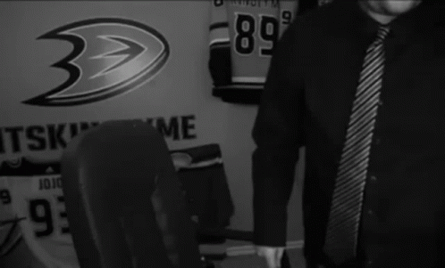
Banbans kindergarten 🧑🏻‍🏫🏫
Someone walked into banbans kindergarten and Banban said “hi what is your name?” I said “my name is cooper,” he said “oh hi there cooper my name is banban”.I was about to say something until me and banban heard gunshots. We knew that world war 3 was happening. I peeked out the window and saw people shooting each other me and banban quickly hid under a desk our heart was beating fast. They came in and we held our breath we were relived because the people left so we came out from under the desk. We went to watch tv until the breaking news turned on and they said killers are trying to break into banbans kindergarten! So we got in my car and we drove to the other side of the town. Now me and banban were safe and we were happy until banban turned evil and he attacked me and I died.

