Slide 1
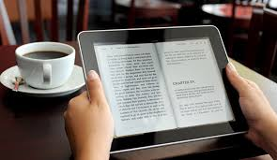
Some Research on the Link between Reading and Learning Outcomes in School

Slide 2
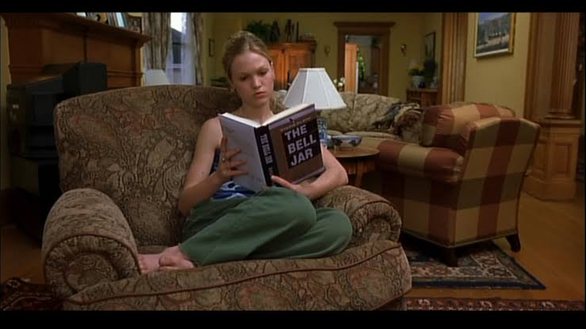
‘Barbara Taylor and Barbara Frye studied the relationship between independent reading and academic achievement.
They concluded that independent reading was the best predictor of reading achievement, and greater time spent reading leads to greater achievement.’ (ibid)

Slide 3
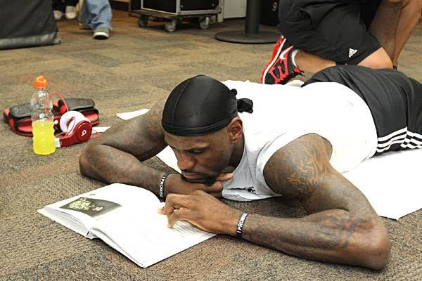
‘Yi-Chen Wu and S. Jay Samuels from the University of Minnesota comparing students who read 15 minutes a day to those reading 40 minutes a day.
They found that students who read 40 minutes regardless of reading level made much higher gains in their reading than students who read 15 minutes.’ (Witter, M. 2013 p.10)

Slide 4
‘Reading researcher Thomas Gunning, in response to ways schools can increase achievement after No Child Left Behind, concluded that nothing is better in building higher-order thinking skills than independent reading.’ (ibid)

Slide 5
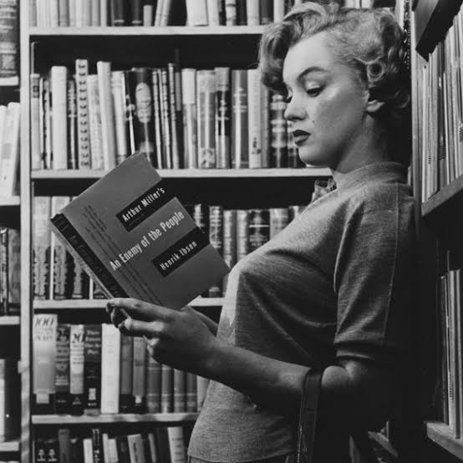
Stephen Krashen studied independent reading over the past 40 years in The Power of Reading. His research concluded that there is no other literacy activity that you can do that will raise achievement in comprehension, vocabulary, spelling, and writing more than independent reading.’ (ibid)

Slide 6
‘Richard Allington (1994) notes that high-achieving students spend much more time reading than their lower-achieving counterparts, providing evidence that time spent in independent reading makes a difference. Reading actually makes you smarter (Stanovich 2000), and our kids need to know this.’ (Harvey and Goudvis, 2017, p.23)

Slide 7
Students learn about 90% of their words incidentally (not through explicit instruction in class).
Researchers have found that the best predictor of a kid's vocabulary size is based on the amount of time they spend reading. (Witter, 2013, p.262)
Vocabulary knowledge is also one of the best predictors of student success in school. (Templeton et. Al., 2014)

Slide 8
Tess Gallagher’s reasons for reading:
... reading is rewarding.
... reading builds a mature vocabulary.
... reading makes you a better writer.
... reading is hard and "hard" is necessary.
... reading makes you smarter.
... reading prepares you for the world of work.
... reading well is financially rewarding.
... reading opens the door to college and beyond.
... reading arms you against oppression.

Slide 9
References:
Witter, M. 2013. Reading Without Limits. Jossey-Bass. San Francisco.
Harvey S. and Goudvis, A. 2017. Strategies That Work (Third Ed.). Stenhouse Publishers. Ontario.
Templeton, S. et. al. 2014. Vocabulary Their Way (Second Ed.). Pearson Higher Ed. USA.

