Slide 1
:
Section B
General Knowledge and Skills
One extended writing task
25 mathematics, science and technology multiple-choice questions
25 arts and humanities multiple-choice questions

Slide 2
Section B Writing Task
asks students to develop a piece of writing presenting a point of view in response to several prompts. In addition to utilising the information provided, students can draw on their own ideas to communicate clearly and effectively to the reader. The writing task will take about 30 minutes to complete.
Writing will be judged on:
• the extent to which students develop their point of view in a reasonable and convincing way
• how effectively students express themselves.

Slide 3
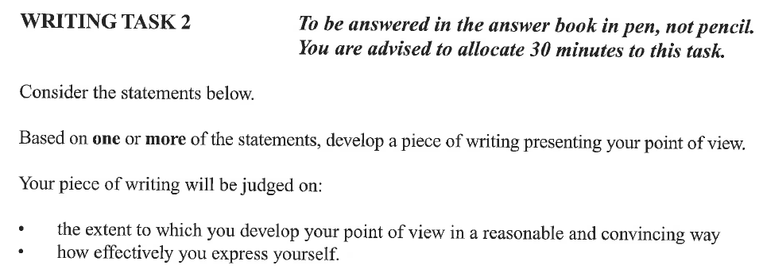
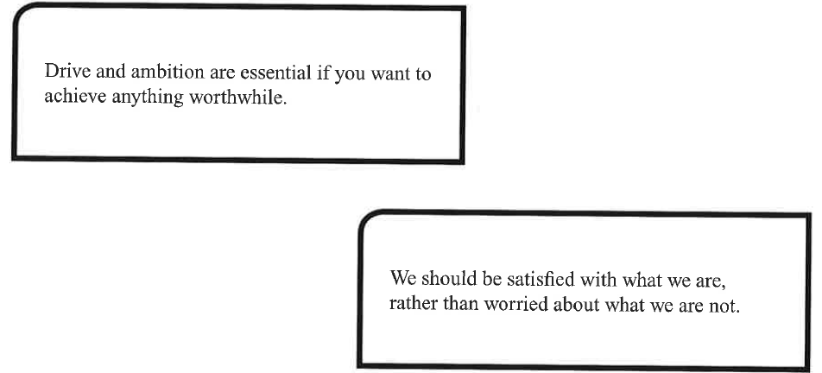

Slide 4
Section B Multiple-Choice questions
cover mathematics, science, technology, humanities, the arts and social sciences
you should attempt every question
marks will not be deducted for incorrect answers
this section consists of groups of questions or units
each unit will offer one or more pieces of information with several questions relating to that information.

