Slide 1
Leon Davis By
Joshua Stephens

Slide 2
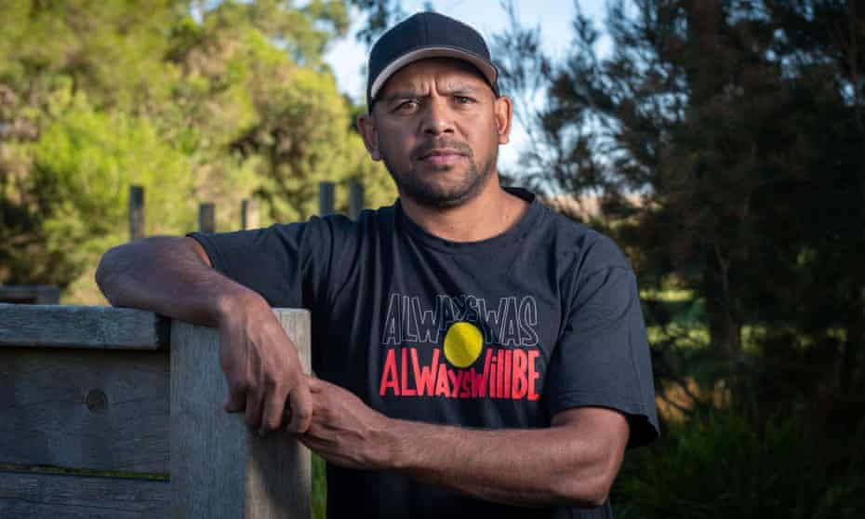
Leon DAVIS PERSONAL INFORMATION
Date of birth: 17th June 1981.
Nicknames: Neon Leon and Magic
Born: Northam, Western Australia
Leon Davis has two brothers
He has 5 children. 3 Sons and 2 Daughters

Slide 3
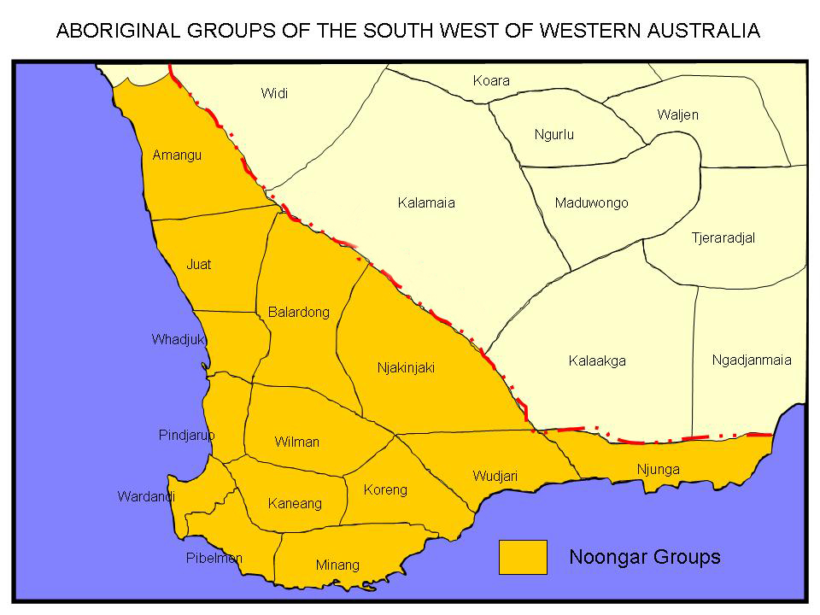
Leon Davis place OF BIRTH/ABORIGINAL COUNTRY
Place of birth: Northam, Western Australia
Indigenous country: Kaneang

Slide 4
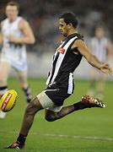
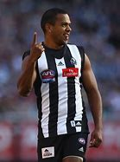
Achievements
Playing as a forward/ defender for the Collingwood football club.
Goal of the year in 2008
In 2005, Davis played his 100th game, becoming the first Aboriginal player to do so for the Collingwood Football club.
In 2008, Davis came 4th in the Copeland Trophy, Collingwood's best and fairest award, and represented the Dream Team in the AFL Hall of Fame Tribute Match.

Slide 5
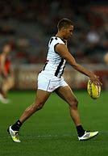
Interesting facts
Davis is a specialist at the banana kick shot at goal, which has earned him several nominations for "Goal Of The Year", although his Goal of the Year victory in 2008 was not from such a kick.
Originally from Northam, Western Australia, Davis played for Perth before being drafted by Collingwood in the 1999 National Draft. He made his senior debut{1st match} for the club in 2000, and went on to play in grand final losses in 2002 and 2003
Total AFL Games = 225

Slide 6
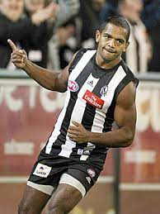
How this person inspires people
A great Collingwood player for the AFL.
Because he played for Collingwood who has a very large fan following, he inspired many people young and old. So much so that he even inspired people that did not barrack for Collingwood.

Slide 7
refrences
https://www.google.com/search?q=leon+davis+pictures&tbm=isch&ved=2ahUKEwiUyKzOm4fxAhV8LLcAHfyzBU8Q2-cCegQIABAA&oq=leon+davis+pictures&gs_lcp=CgNpbWcQAzoICAAQsQMQgwE6BQgAELEDOgIIADoECAAQQzoHCAAQsQMQQzoECAAQGFCCDFikXmDdZGgBcAB4BIABvQKIAZskkgEIMC4xNy42LjKYAQCgAQGqAQtnd3Mtd2l6LWltZ7ABAMABAQ&sclient=img&ei=NPS-YJTeMvzY3LUP_OeW-AQ
https://en.wikipedia.org/wiki/Leon_Davis_(footballer)#:~:text=Leon%20Davis%20(born%2017%20June,Australian%20Football%20League%20(AFL).&text=He%20was%20awarded%20a%20premiership,the%20replay%20that%20Collingwood%20won.
https://www.google.com/search?q=indigenous+map+of+western+australia&tbm=isch&ved=2ahUKEwi4x_W0ponxAhUXoUsFHfqXDocQ2-cCegQIABAA&oq=indigenous+map+of+wes&gs_lcp=CgNpbWcQARgAMgIIADoECAAQHjoGCAAQBRAeOgYIABAIEB46BwgAELEDEENQo2lYlI8BYNCfAWgAcAB4AIABjAOIAc0akgEHMC4zLjkuMpgBAKABAaoBC2d3cy13aXotaW1nwAEB&sclient=img&ei=9wvAYPjvLpfCrtoP-q-6uAg#imgrc=z0LwzwuKYzRWMM

