Slide 1
Welcome to Toddle, Families!

Slide 2
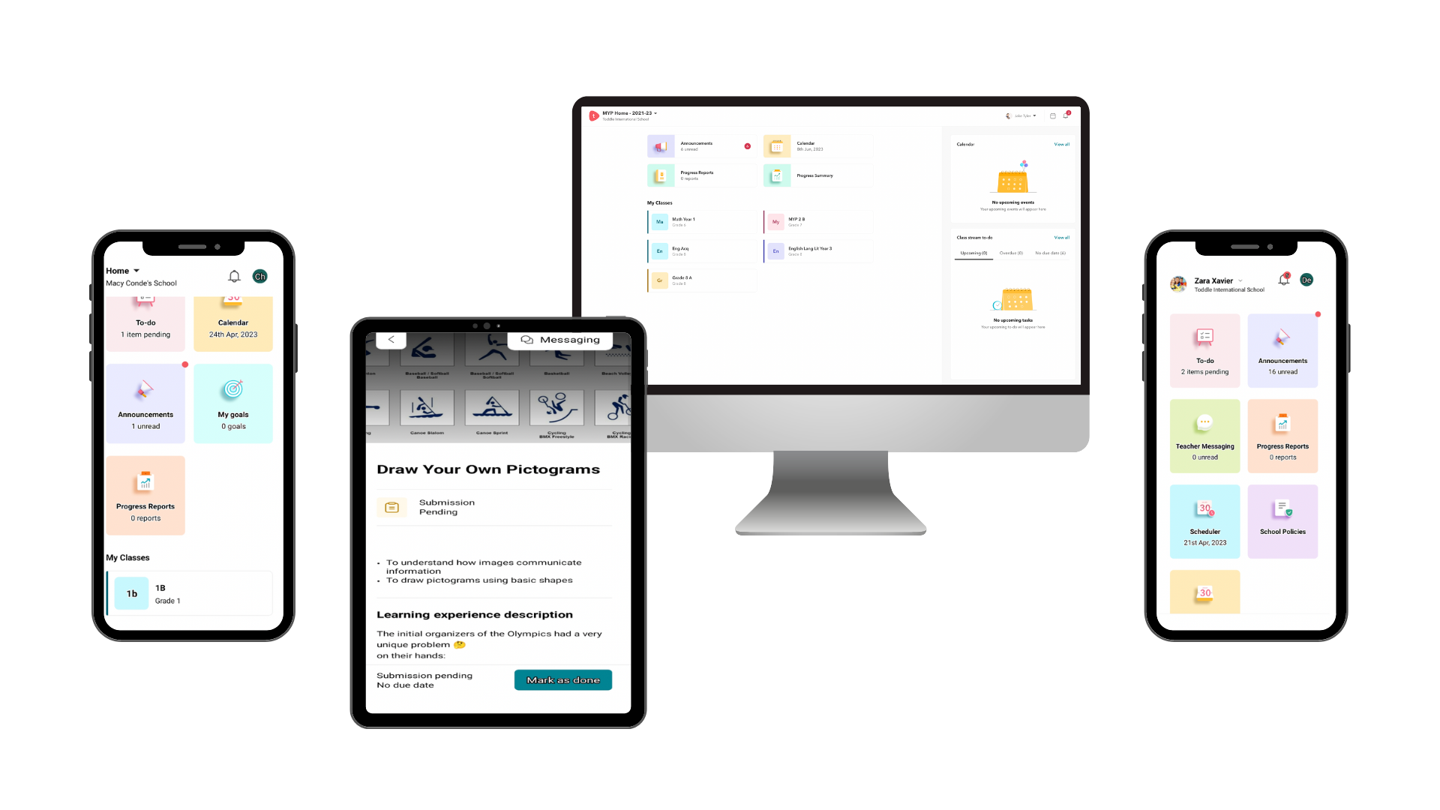
Experience the convenience of Toddle across multiple platforms
Family app
3
Web Portal
1
Student App
2
Notes:
Toddle can be downloaded to a variety of platforms. The Student app is used by the students to upload their evidence and complete learning on school iPads for Foundations to Year 2 and on their own iPads for Years 3 to 6. The family app is downloaded by families to view their students portfolio. All parents have been invited to Toddle via email.

Slide 3
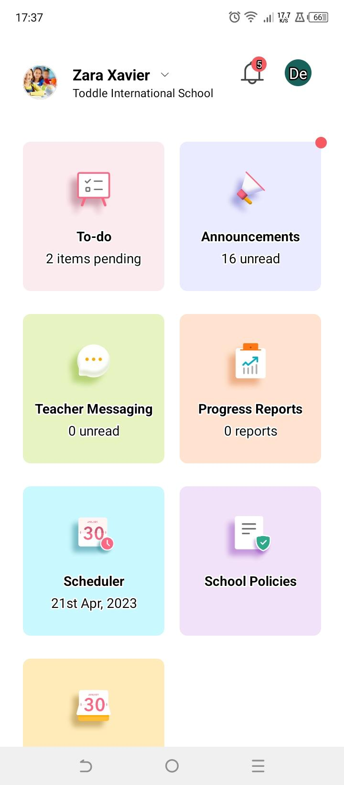
Your Toddle Homepage
Child’s name
School’s name
Essential widgets
Child’s class

Slide 4
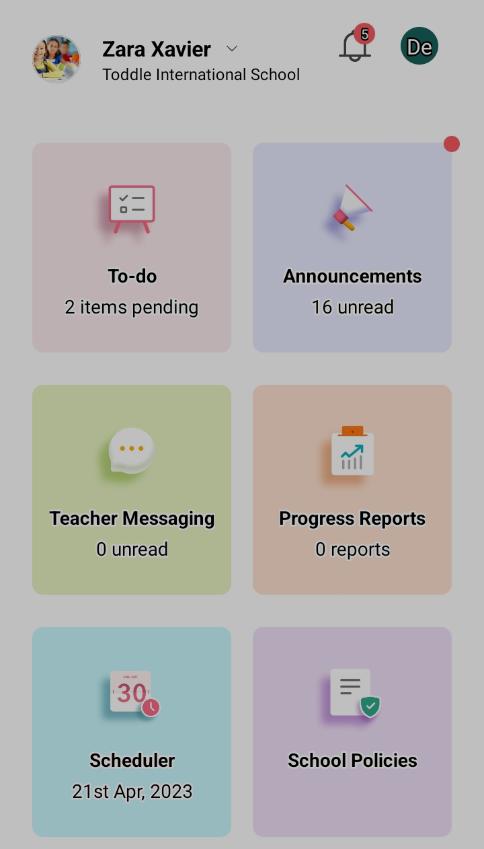
On the Family app
Class to-do
Easy access to the important tasks, and deadlines of your child

Slide 5
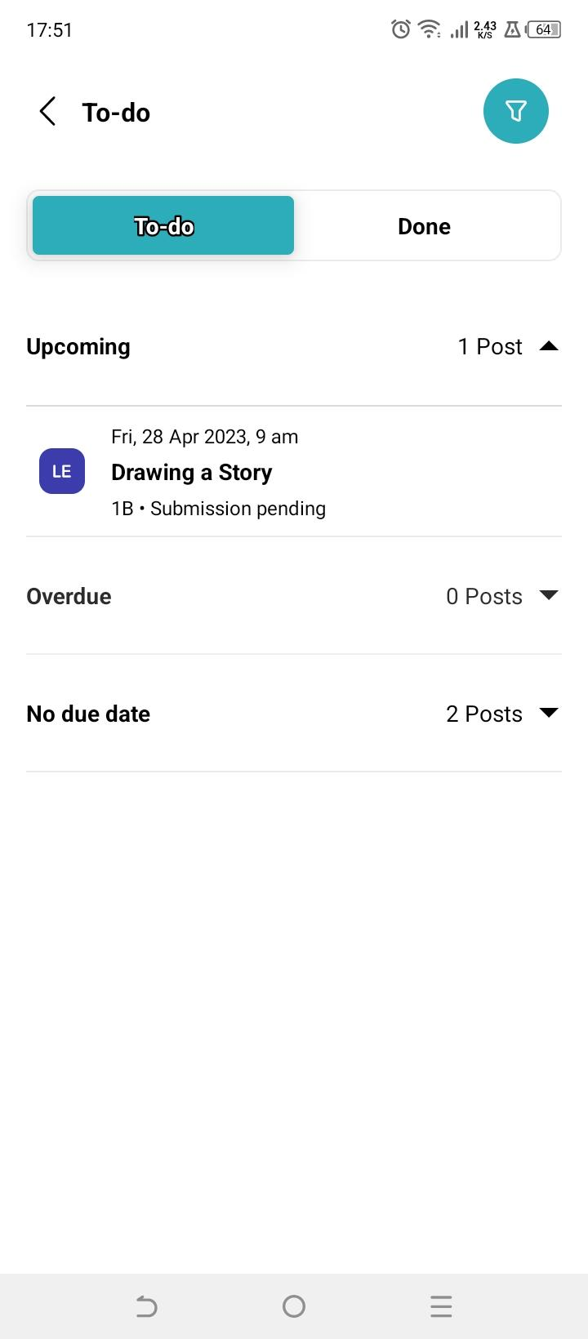
On the Family app
Class to-do
View upcoming tasks and their due dates
Get alerted on tasks that are overdue and support your child in completing them

Slide 6
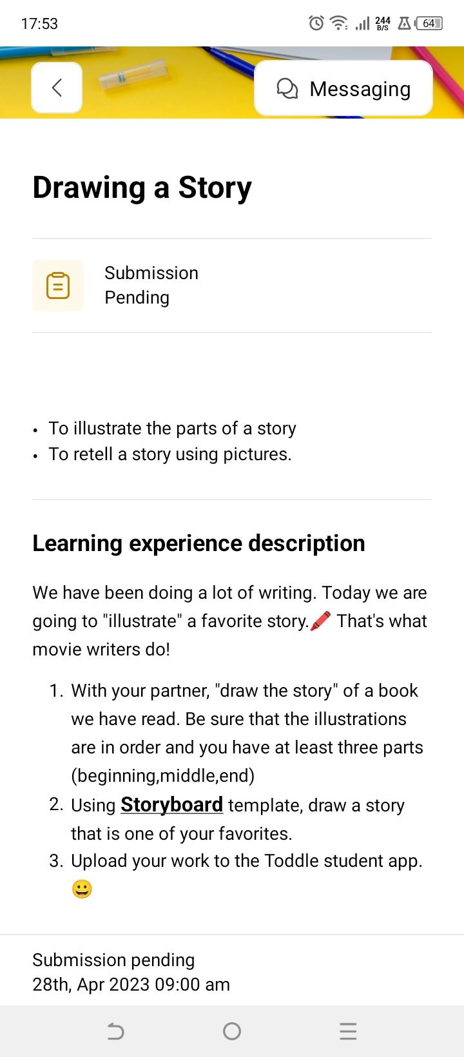
On the Family app
Class to-do
Learn more about the tasks assigned to your child
Provide better guidance and support in completing the task

Slide 7
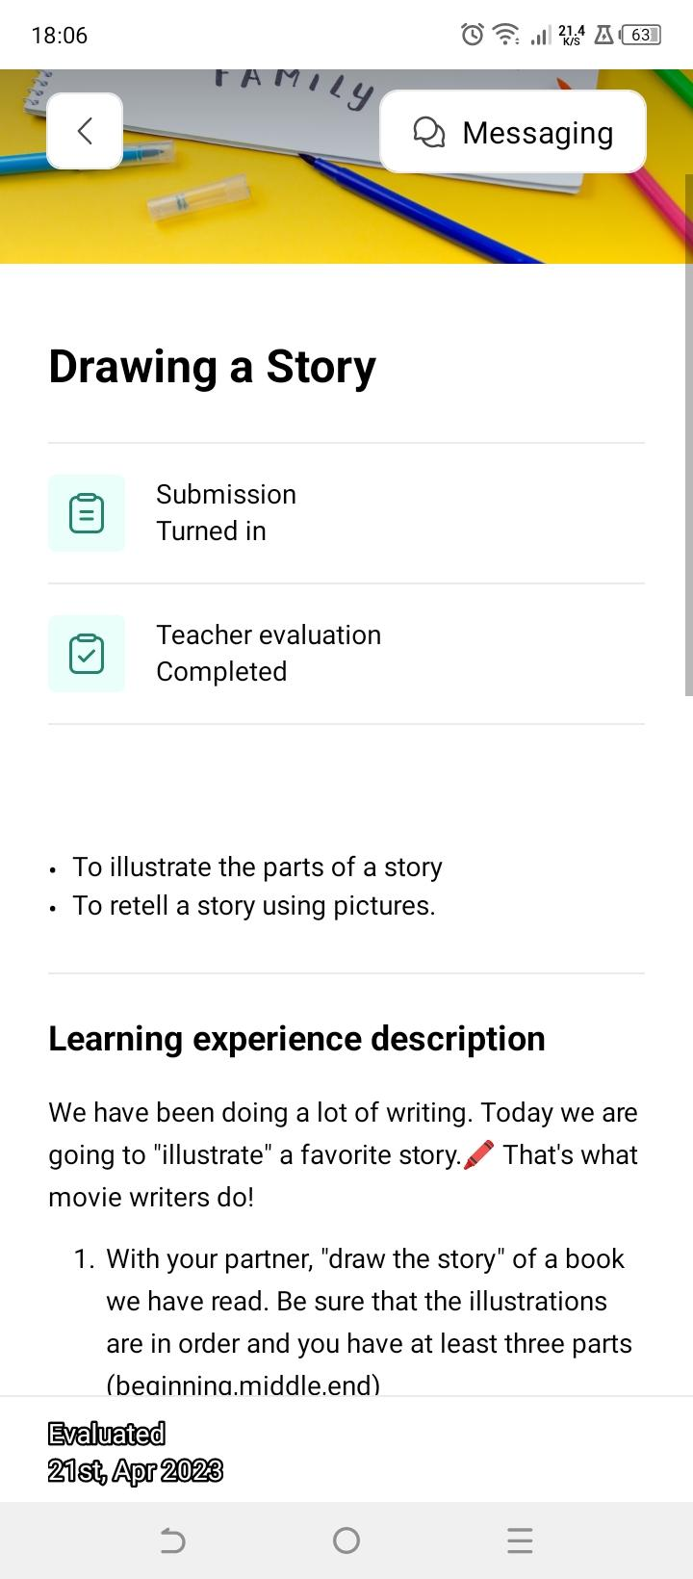
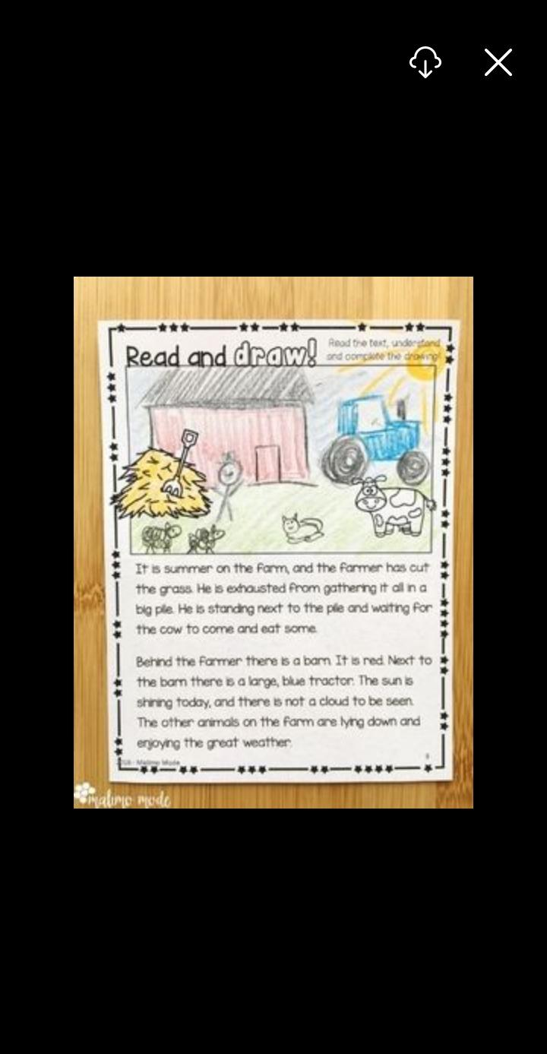
On the Family app
Class to-do
Access your child's submitted work

Slide 8
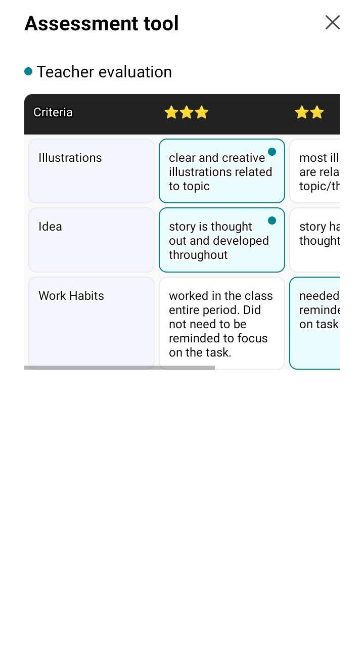
On the Family app
Class to-do
Enables you to know how your child was assessed and how they performed in their submitted tasks

Slide 9
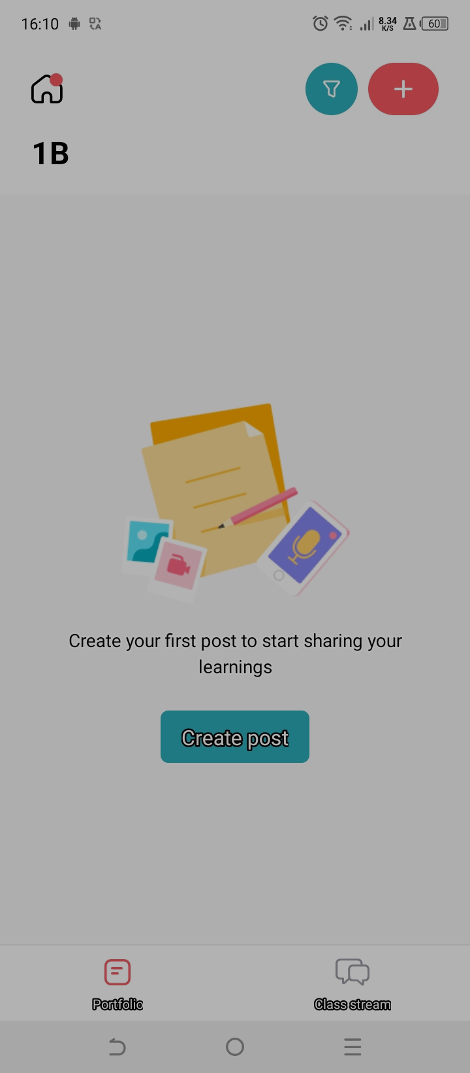
On the Family app
Student Portfolio
How to get access:
1
Scroll down and find your child’s class.
Click on the portfolio tab
2
1
2

Slide 10
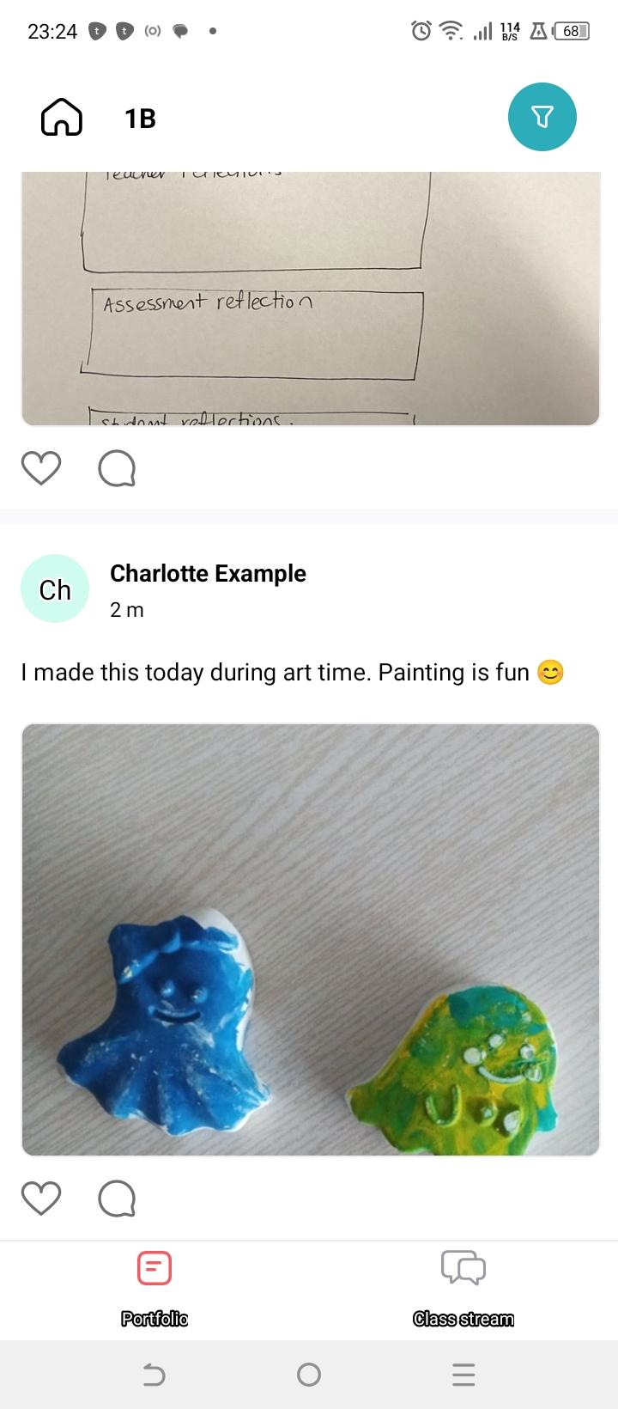
On the Family app
Student Portfolio- Get involved!
1
Take a look at the evidence gathered in your child's portfolio the moment they get posted
Tap the ♡ to show how proud you are of your child’s efforts
Leave a few words of encouragement in the comment section
2
3

Slide 11
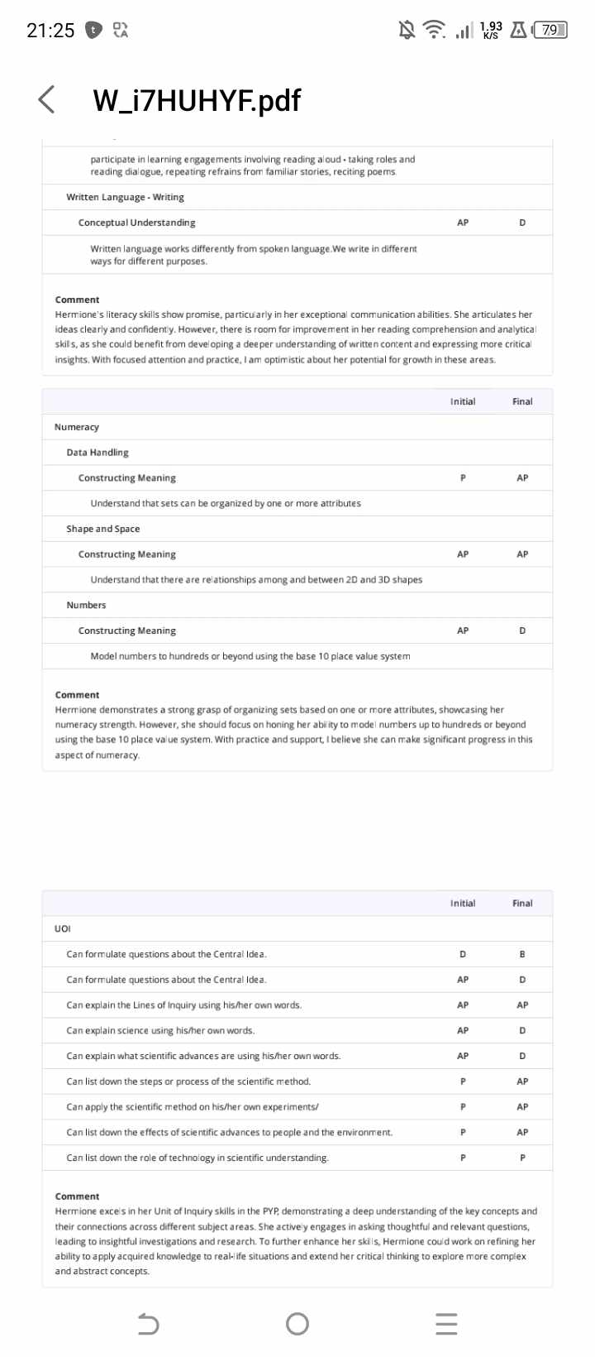
On the Family app
Progress Report
Gives you a digital access to the student’s progress reports
1
2

Slide 12
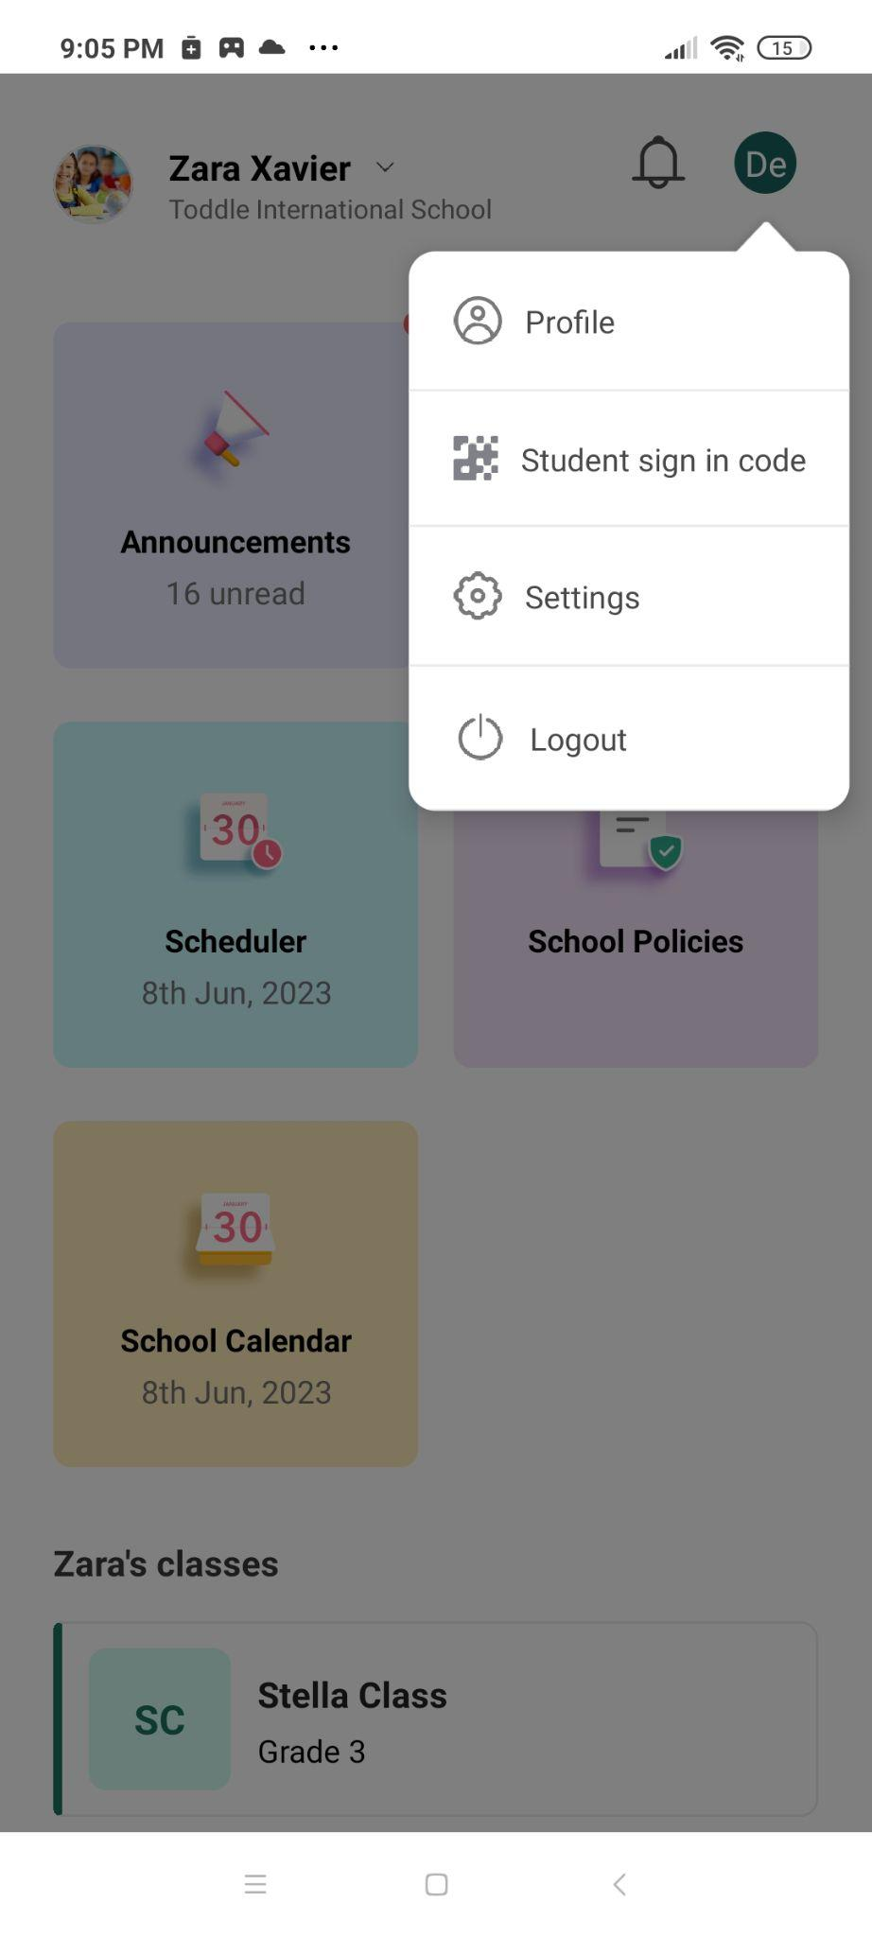
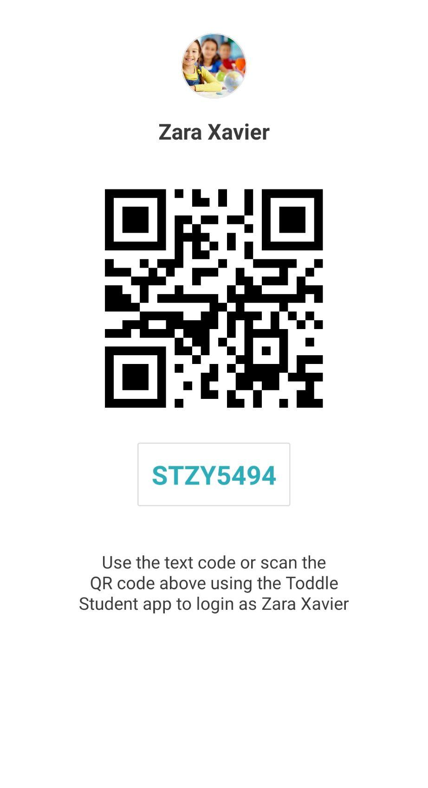
Access your child’s student sign-in code directly from the Toddle Family app

Slide 13
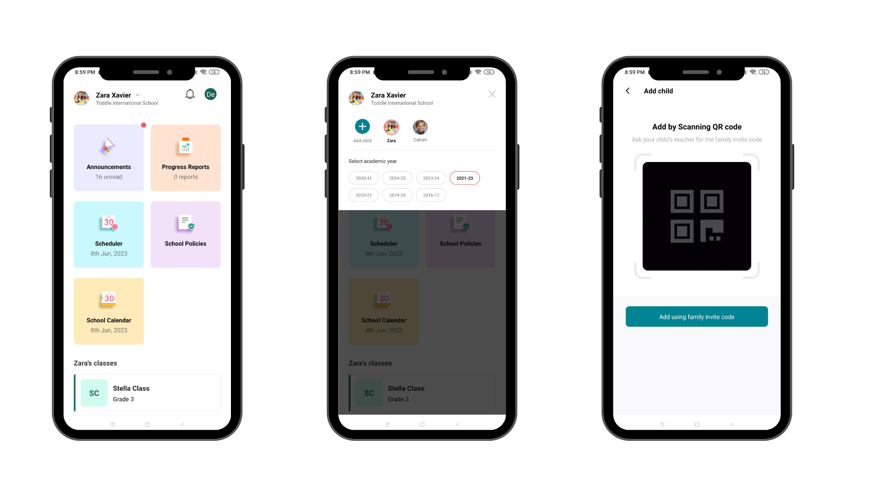
Adding another child to your drop-down list
1
2
3

Slide 14
Once you have successfully signed in using the Toddle app, tap on the arrow next to your child’s name on the homepage and use the ‘+’ button to add another child to your dashboard. You will be prompted to scan the QR code or key in the family invite code. You can find this information in the family invite copy sent by the school for this child. Once done, you will be able to view the dashboard for this child as well. You can add multiple children in the same manner.
1
2
3

Slide 15
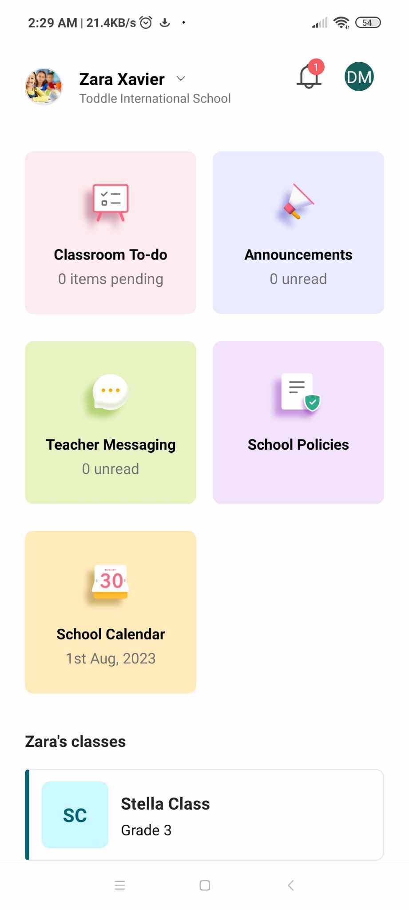
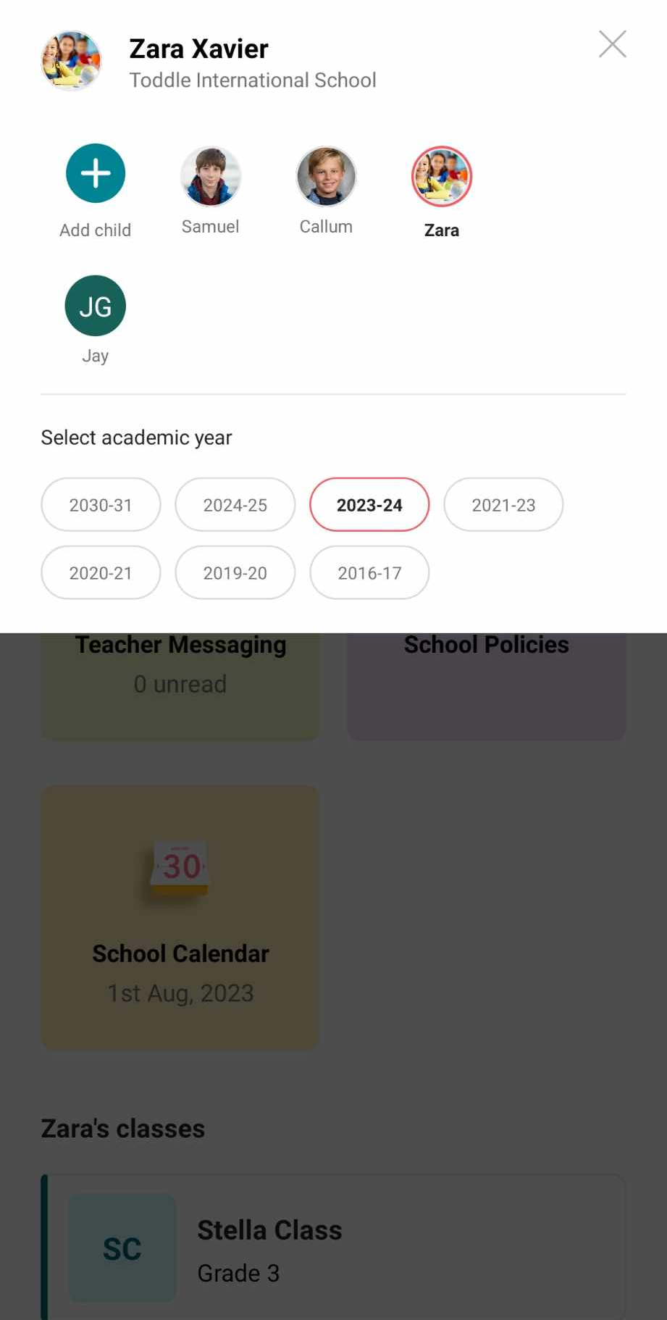
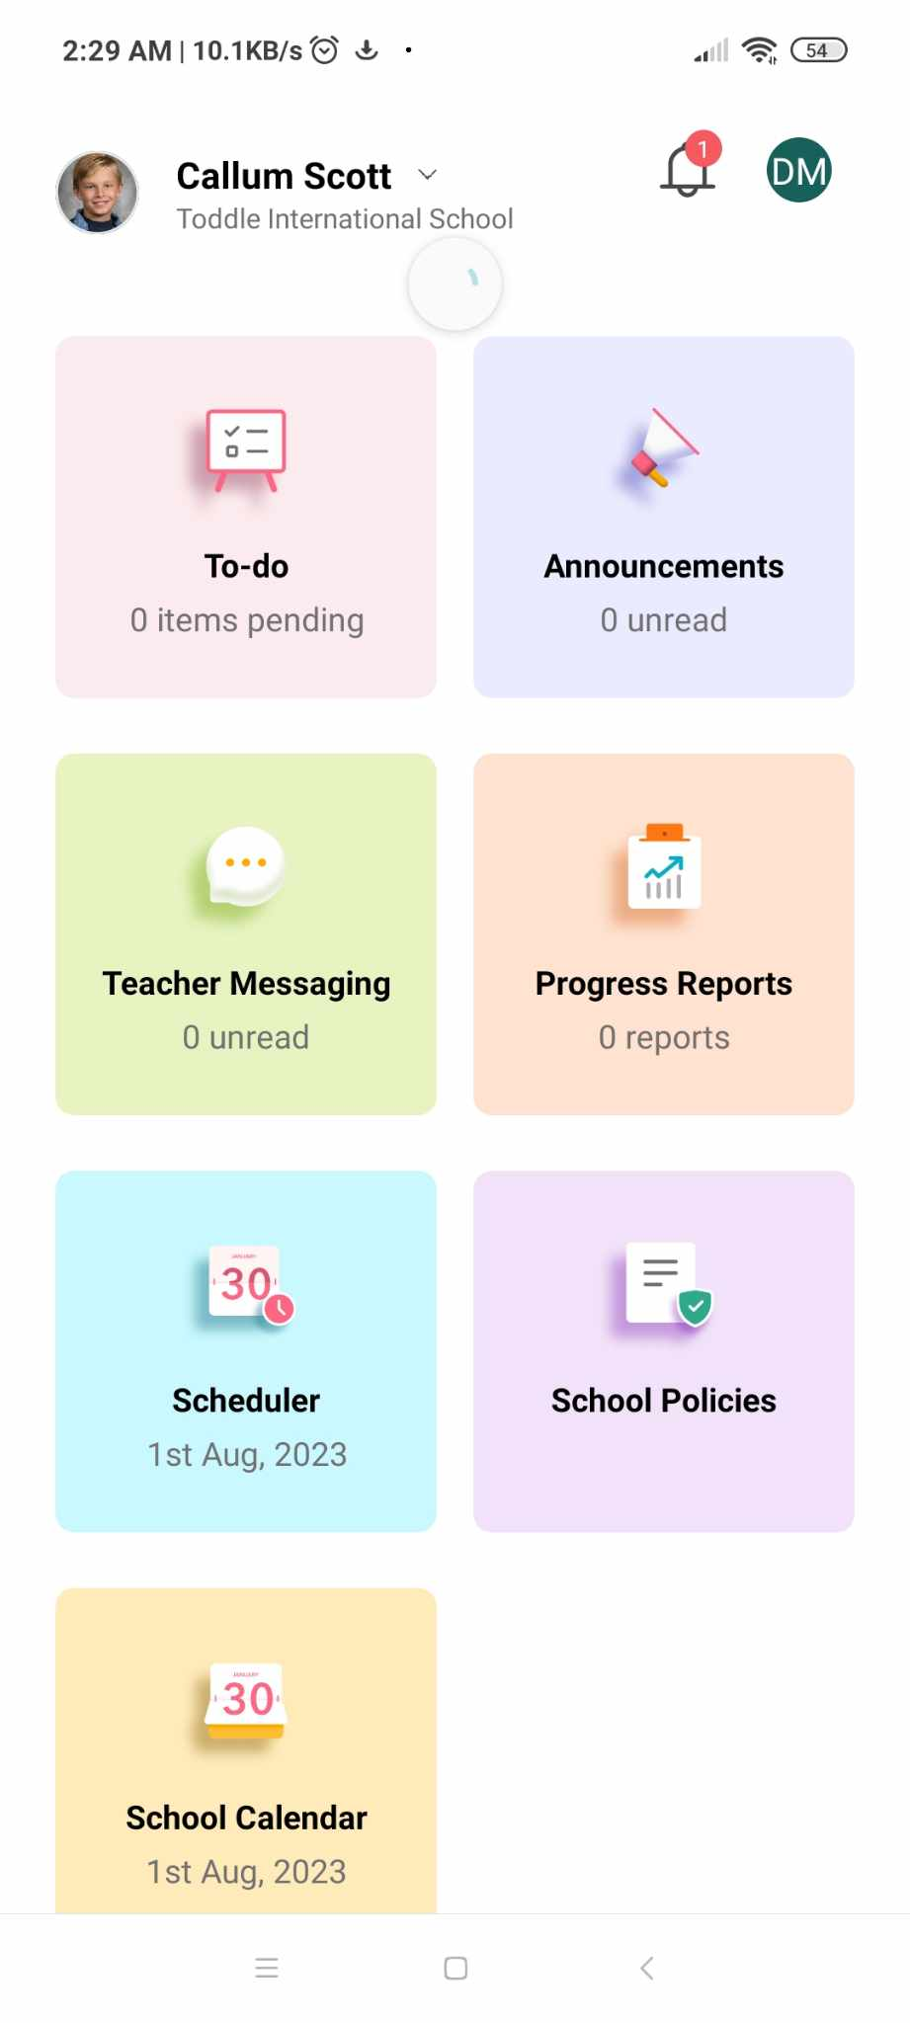
Toggling from one student to another

