Slide 1






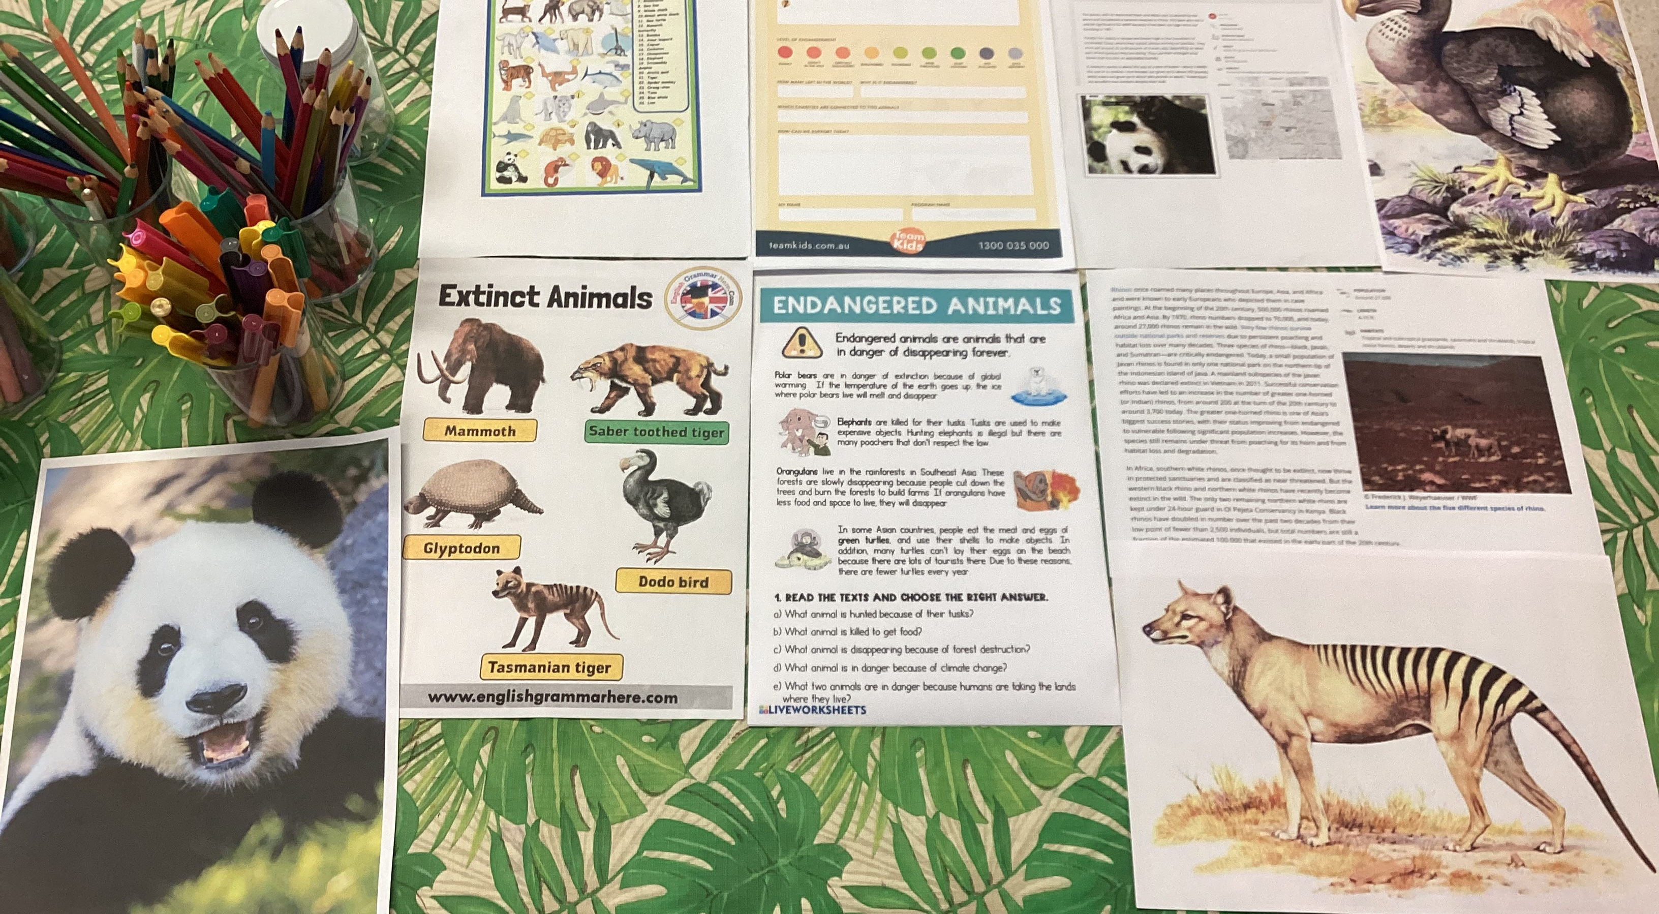
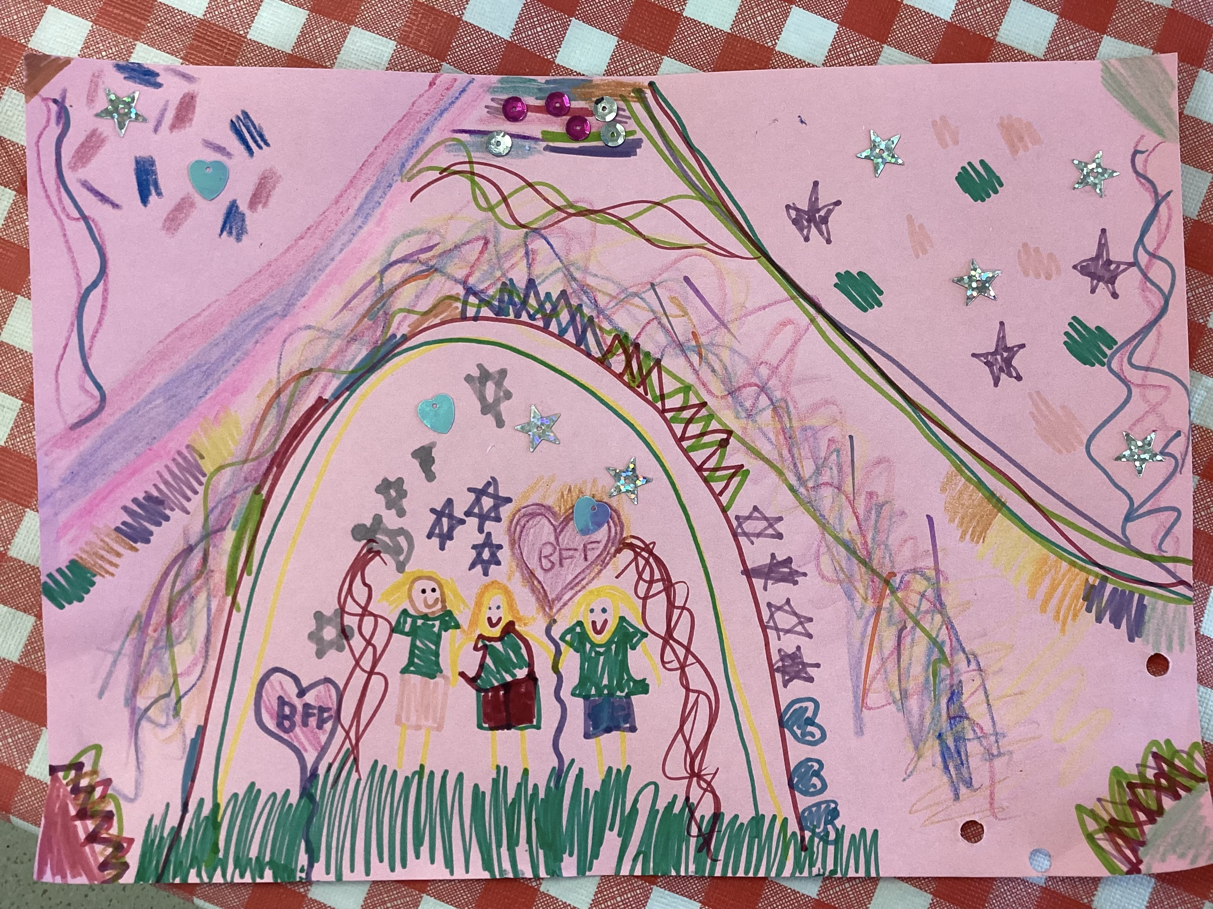
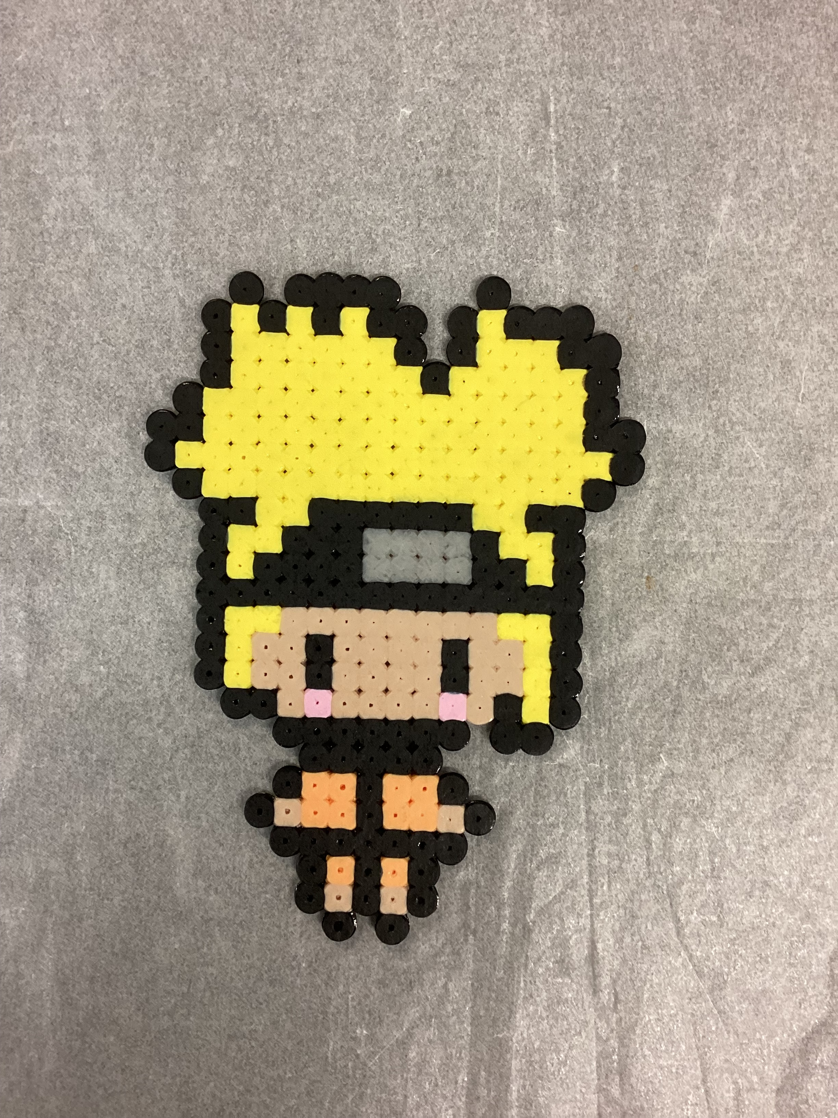
Cheltenham East Team Kids
Dear children and parents,
We are having another busy week in week five. Our new recipe, apple and cinnamon bread, is very successful and received children’s positive feedback. Children love it ☺. We will have another fun cooking activity for apple and cinnamon bread next week. Besides, this week is Team Kids Goes Wild Week, children learnt how to protect endangered animals and our planet.
In addition, children are encouraged to write down their ideas about activities next week on white board. Thanks to their contribution, we can enrich our programs to meet children’s needs at different age. We would like to hear children’s voices and bring them more fun activities ☺.
Also, there will be a family picnic which is to be held on 24th of March. Team Kids will be there and bring children fun games ☺.
We are looking forward to seeing you there☺
Have a great weekend! See you next week.
6
Lego Masters and Art Attack Club
Cooking Club and Musical Theatre
Lego Masters Club and Epic Game
Art Attack Club and Music Theatre
Cooking Club and Epic Games
Wed 08th MARCH
International Women’s Day
Mon 20th March
International Day of Happiness
Thu 24th March
Family Picnic
0432 299 468
CheltenhamEastPS@teamholiday.com.au
1300 035 000
info@teamkids.com.au

