Slide 1
St. Finbar’s Primary School
Playground Safety

Slide 2
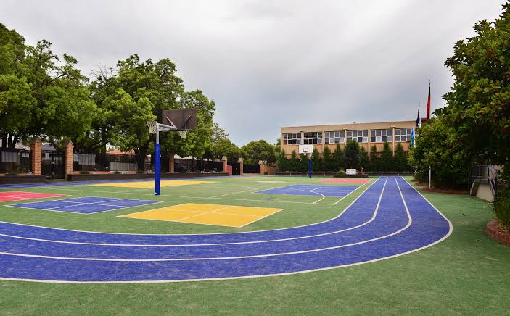
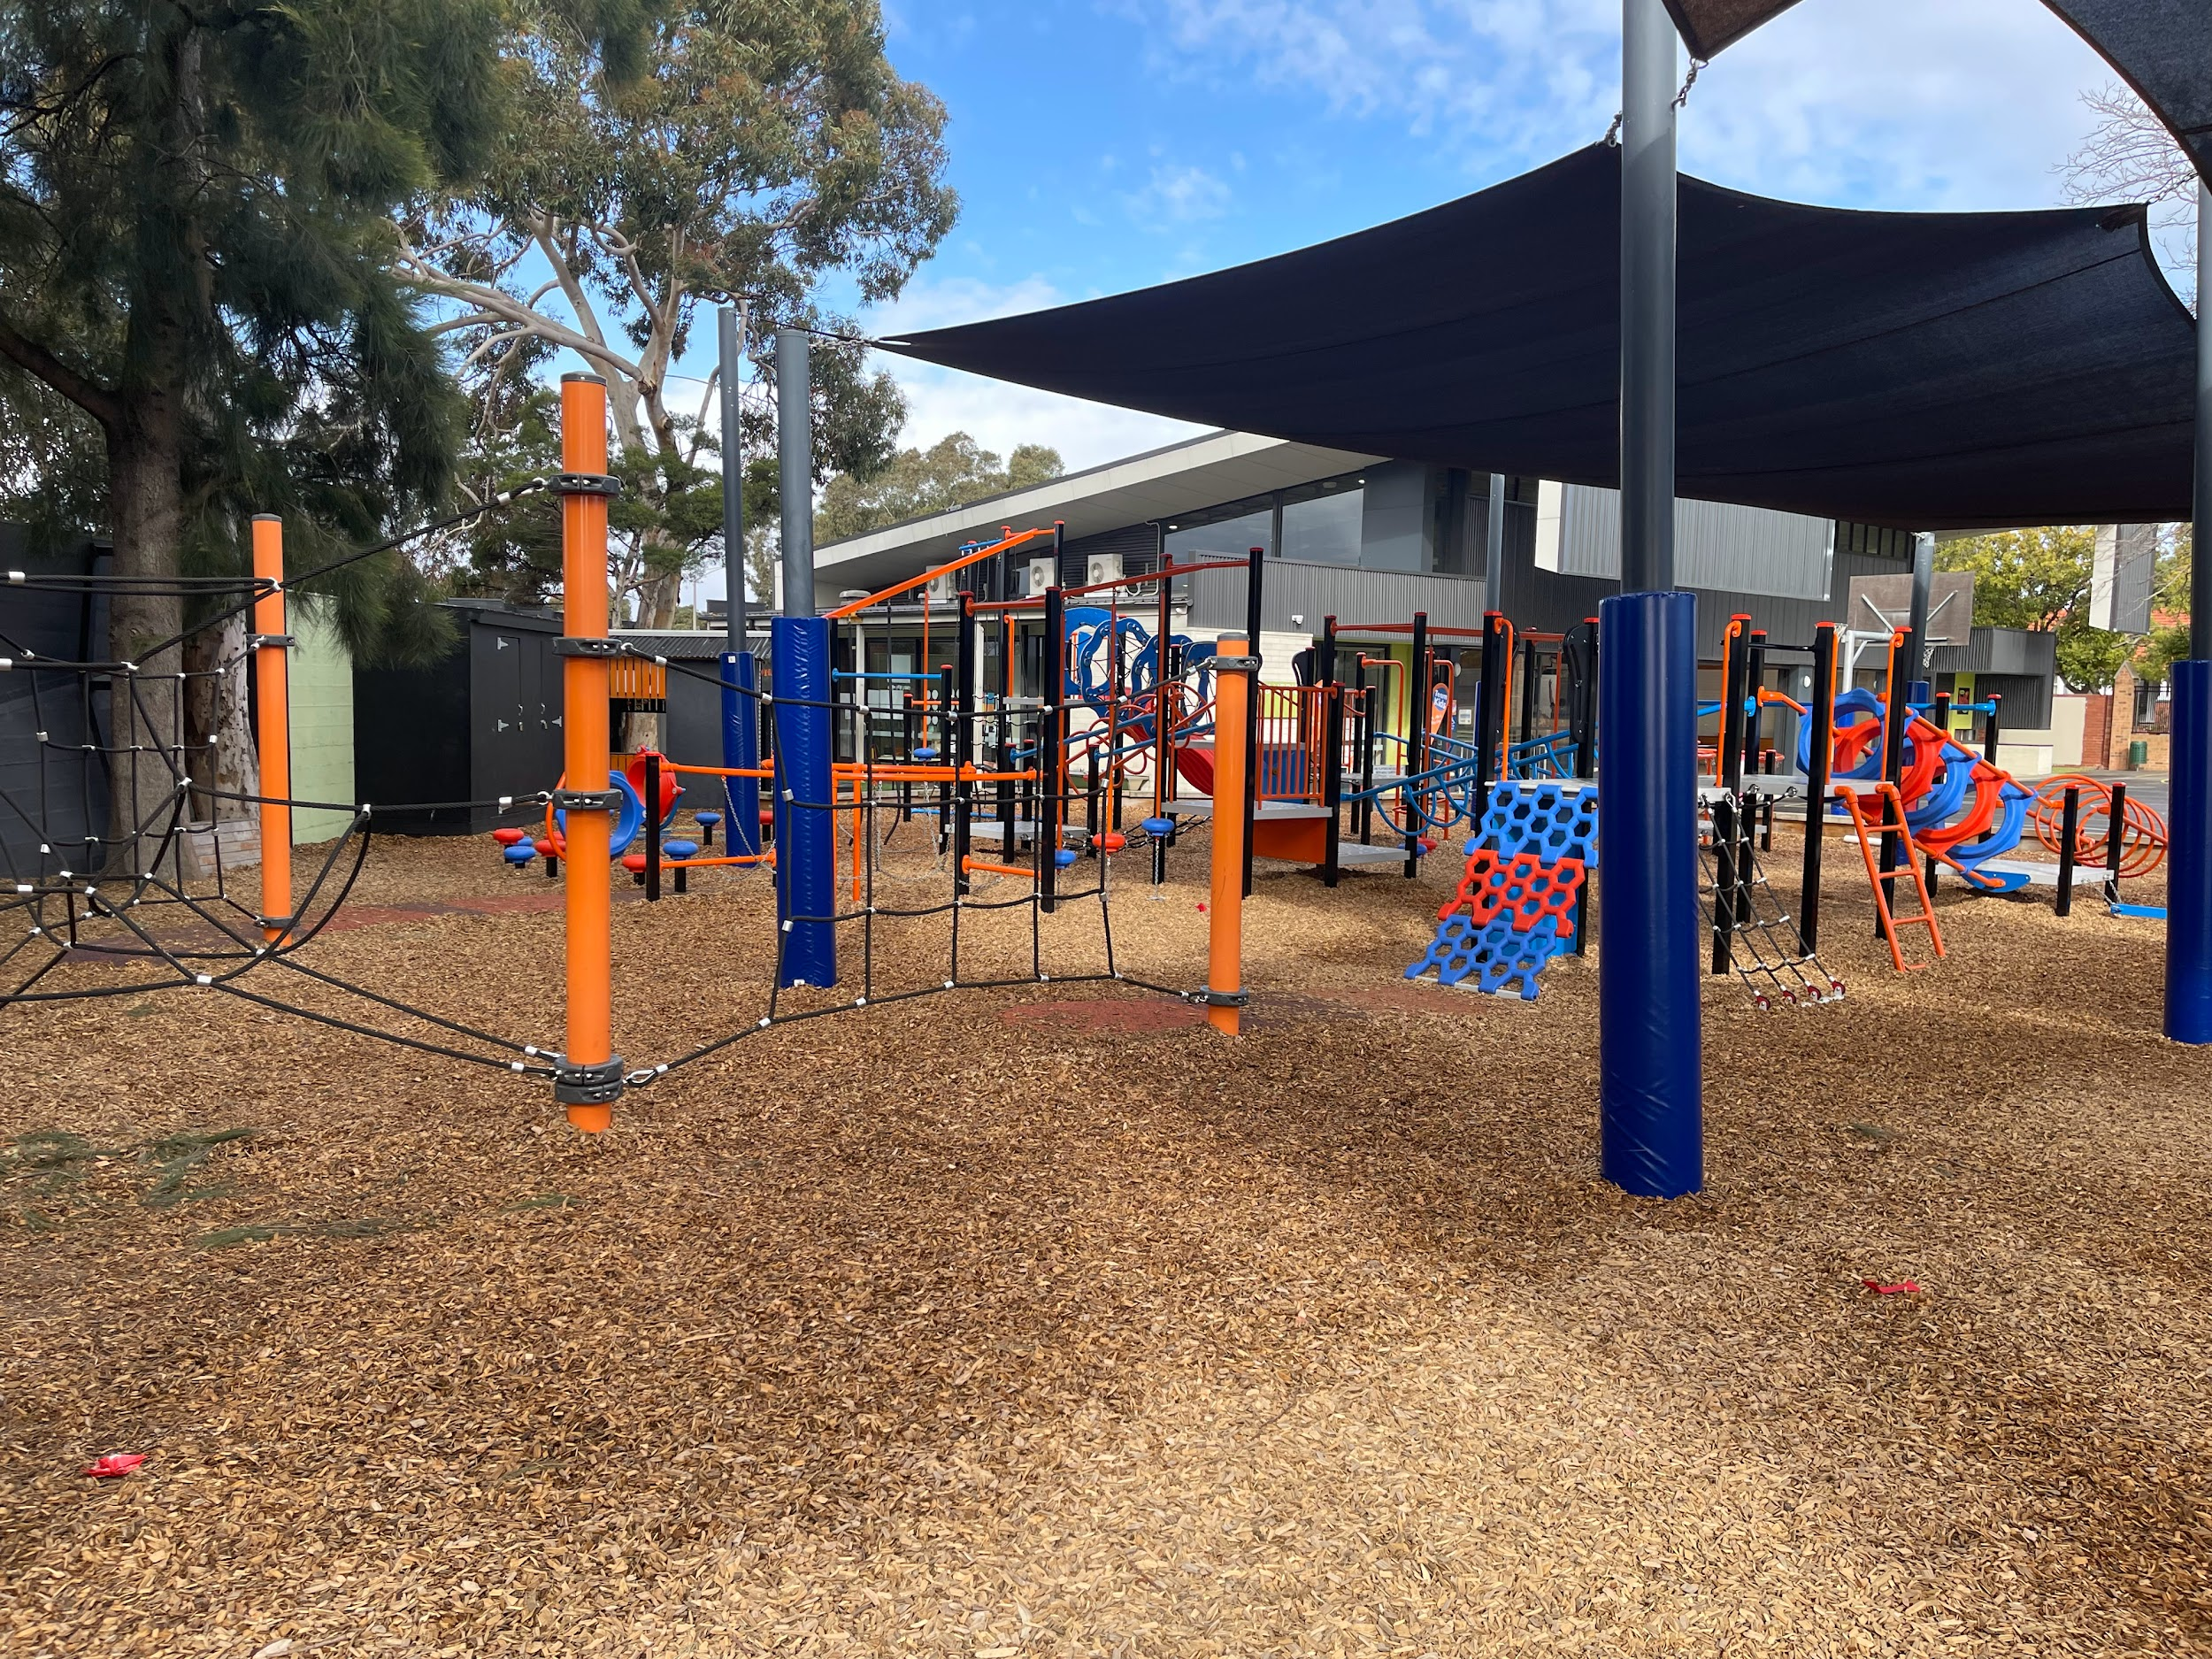
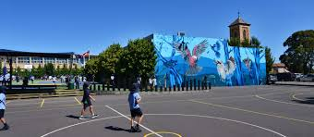
Every day at St Finbar’s we go out to the playground at lunch and snack. This is a time to have fun with our friends but we need to remember a few important things.

Slide 3
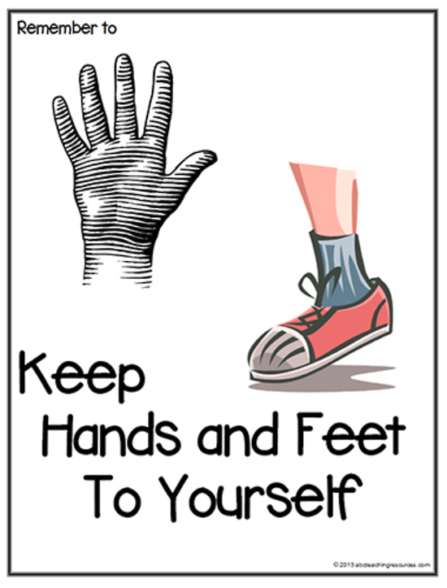
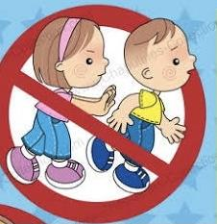
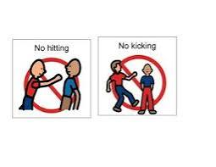
We need to remember our School Rule of
HANDS, FEET and OBJECTS to YOURSELF
We also need to remember to:
wait our turn when using the equipment.
not push other people out of the way as this is dangerous and someone may get hurt.
not play rough games.
be respectful of everyone playing because these are shared spaces for everyone to use.
not hit, punch, kick, pinch or scream at each other.

Slide 4
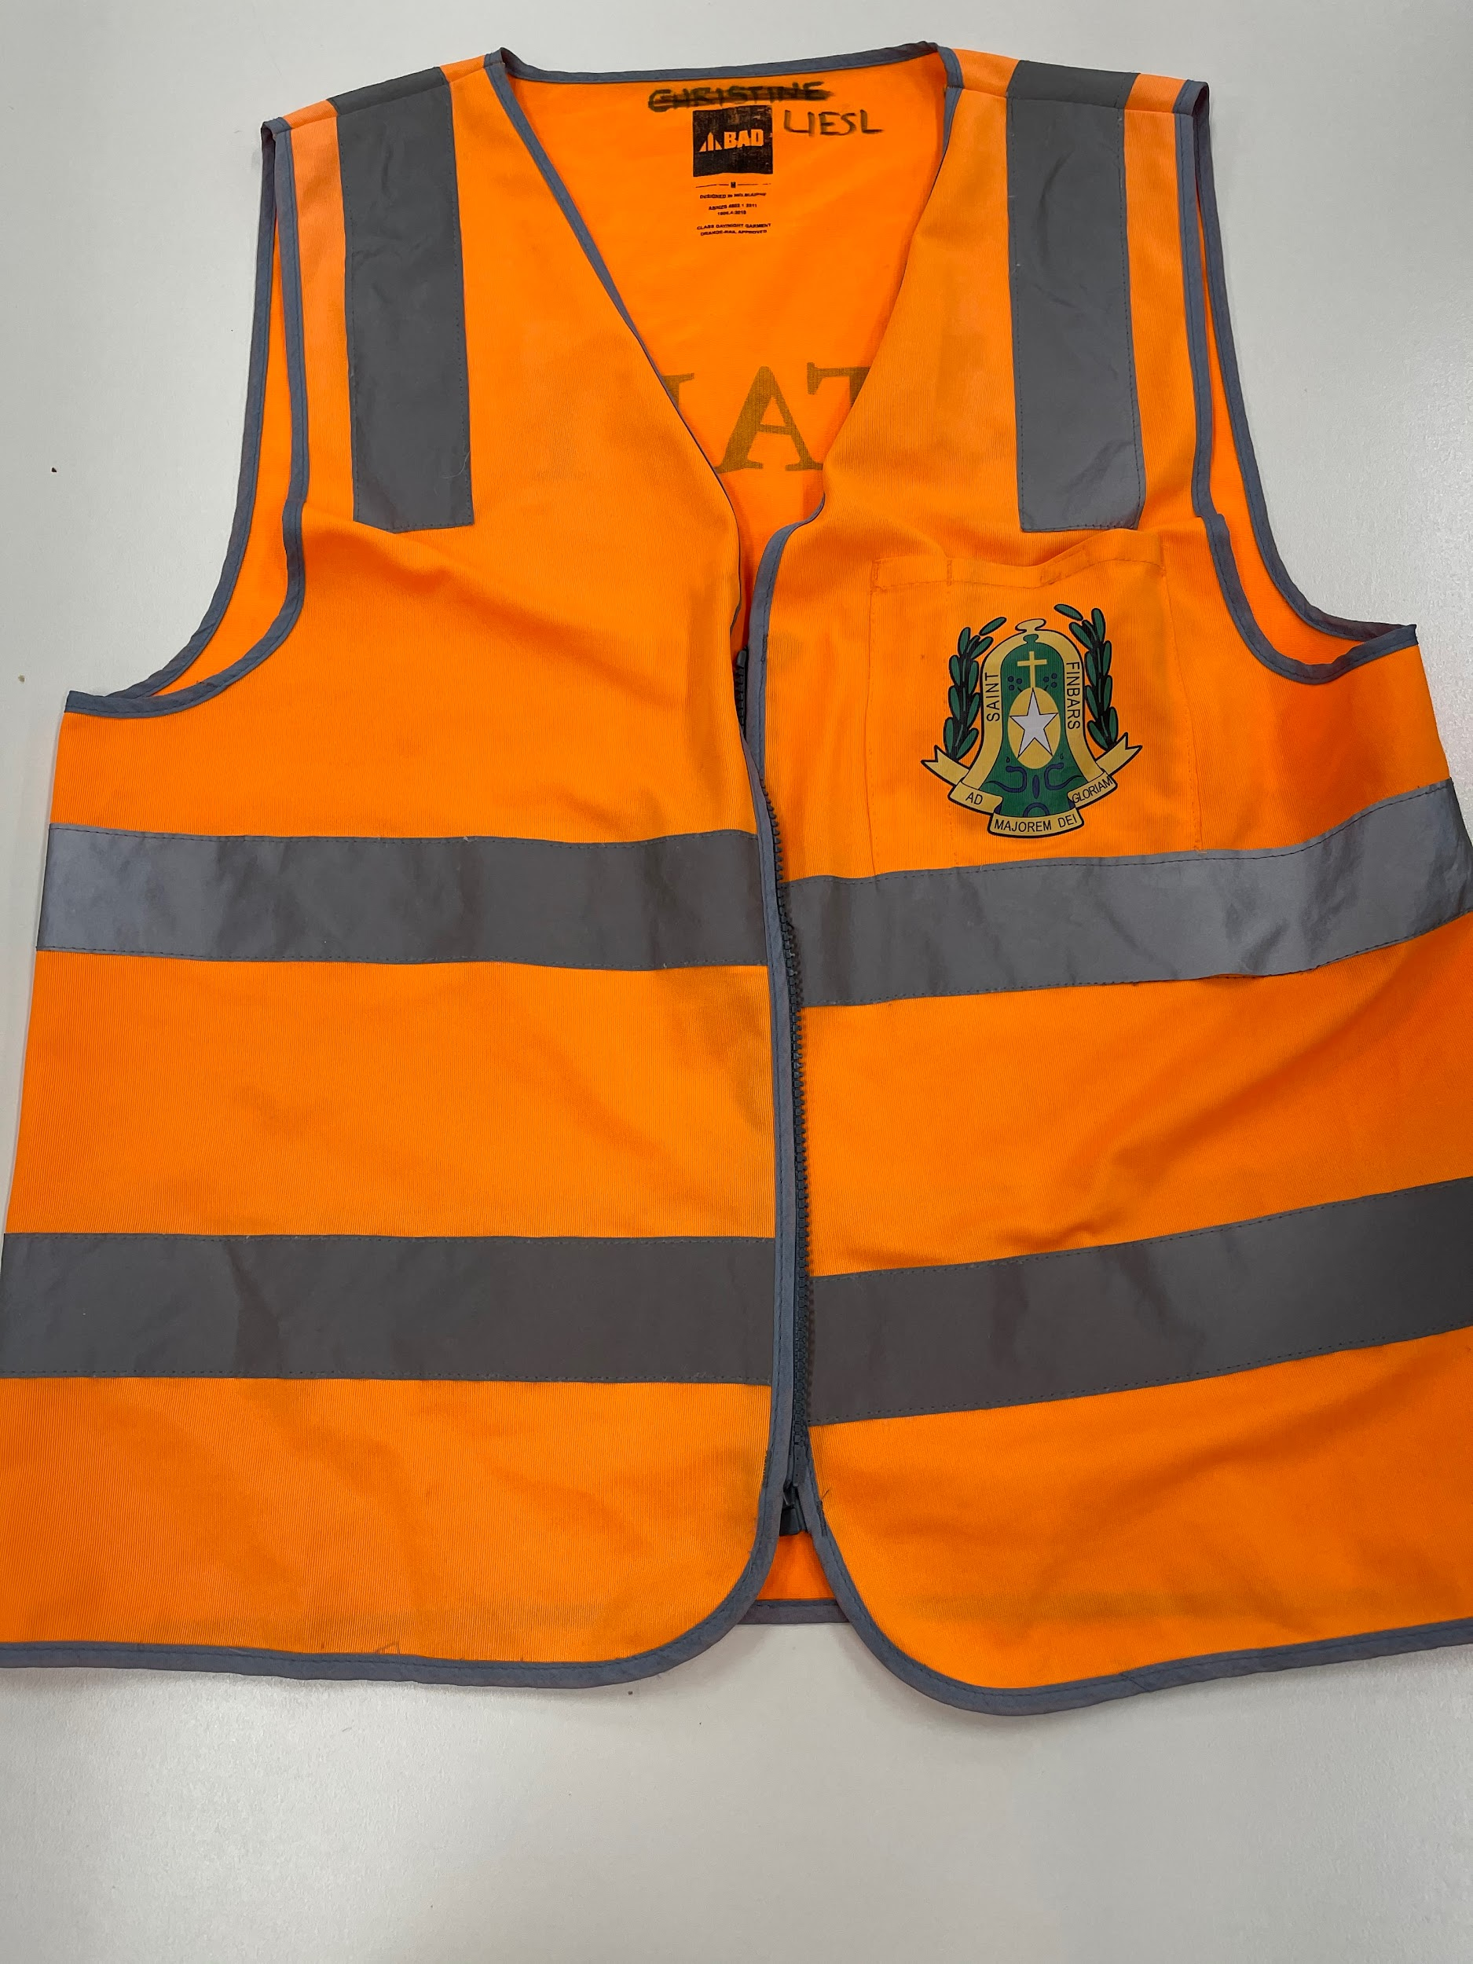
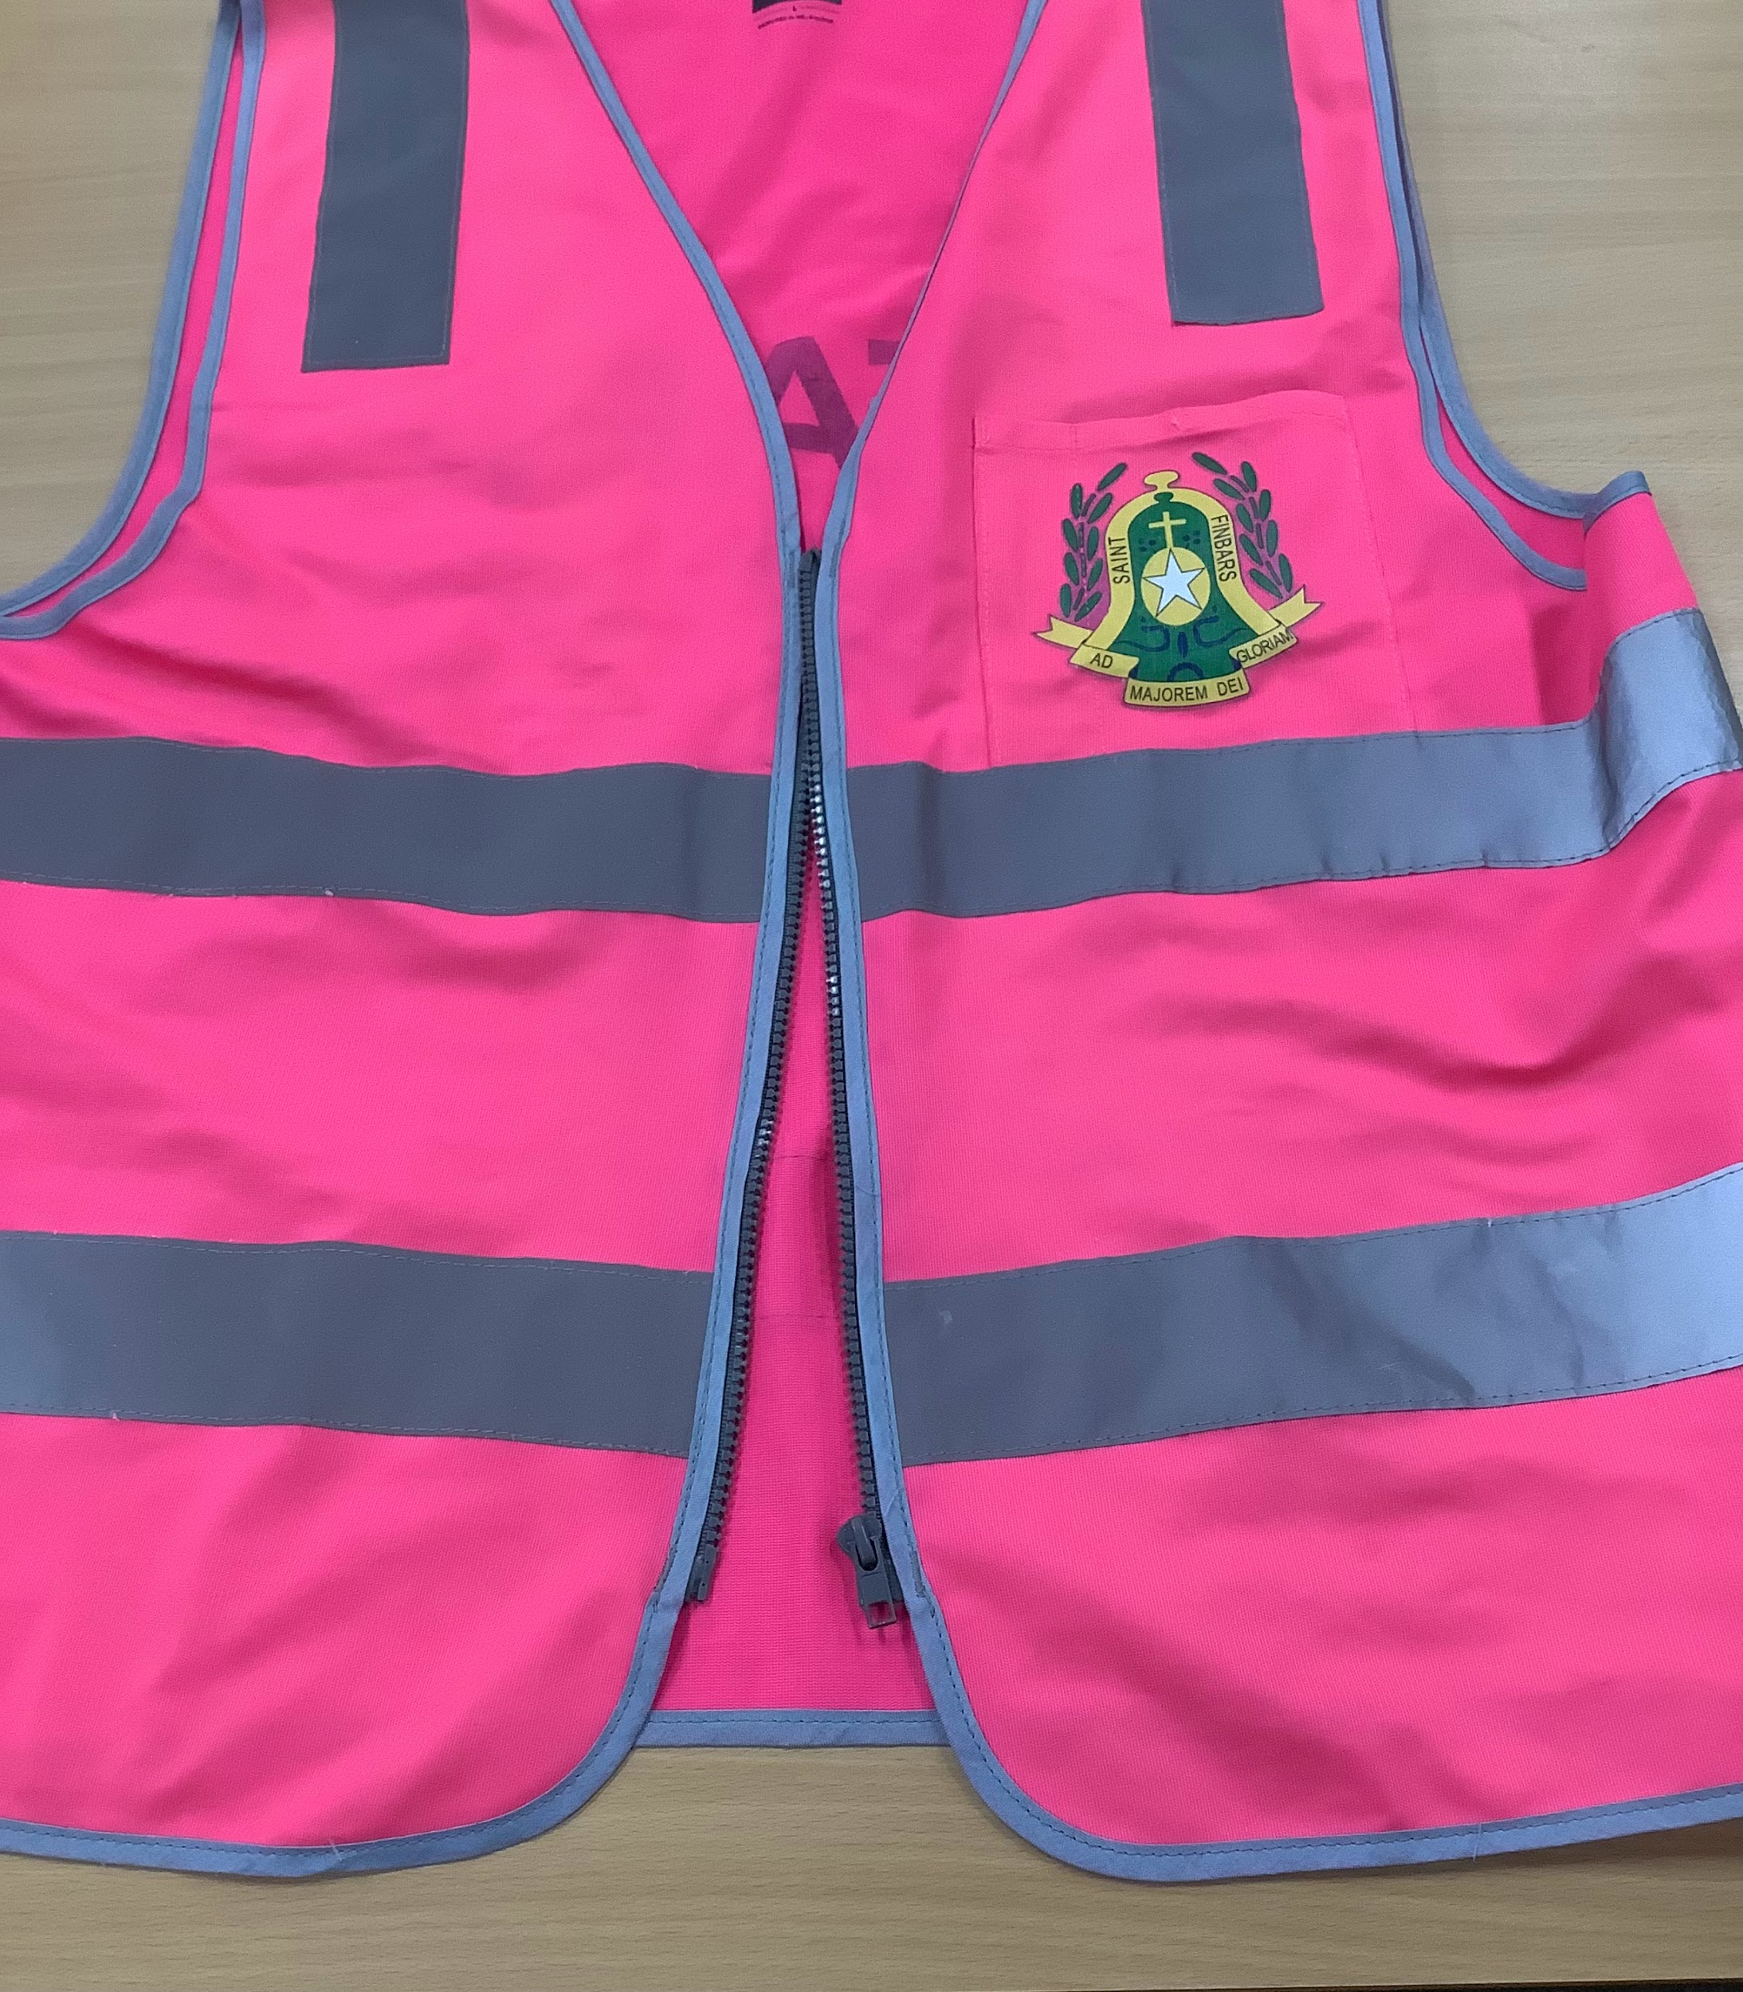
When playing outside we need to remember to listen to any adult with an orange or pink vest.
FOLLOWING DIRECTIONS is one of our School Rules and keeps everyone safe.

Slide 5
If we do not follow our School Rule of HANDS, FEET and OBJECTS to YOURSELF we will have to be sent off the playground and into the office. This means we will miss out on having fun with our friends.

Slide 6
Remembering and reminding each other of these rules makes St. Finbar’s a great and safe place to be.

