Slide 1

Notes:
Opening title screen

Slide 2


Slide 3

WHAT IS A TRAINEESHIP?
A Traineeship is a work placement where you get paid to work and study at the same time. They can be:
Full time (10-12 months)
Part time (12-24 months)
School Based - ASBA (12-24 months)
Traineeships provide you with:
Valuable On-the-Job/Practical experience
Nationally Accredited training at TAFE (eg Certificate III or IV Qualification)
Possibility of ongoing employment or entry to university
Great referees/references and contacts for your future
Notes:
Presentation text / body
To create additional slides – Mouse > Right click > Duplicate slide

Slide 4
WHO IS INVOLVED?
AASN
(MAS National)
Group Training Organisation
(Legal Employer:
AFL SportsReady)
TAFE/RTO
(Deliver the certificate to you )
Host Employer (Company you work with)
Trainee
YOU
Notes:
Presentation text / body
To create additional slides – Mouse > Right click > Duplicate slide

Slide 5
WHO CAN DO A TRAINEESHIP?
Most trainees are people who have recently finished secondary school (Year 12 school leavers) but trainees are available to all age groups from 15 yrs. to > 21 yrs. of age.
People decide to do a traineeship for various reasons, but the most common reasons are:
To do a gap year
Didn’t achieve required results for University
To begin a work career
To gain on-the-job experience
Notes:
Presentation text / body
To create additional slides – Mouse > Right click > Duplicate slide

Slide 6
ROLE OF A FIELD OFFICER
Each trainee is assigned a Field Officer. The Field Officer is always the first point-of-call and manages your traineeship . He or she will be available for any questions, queries or problems that a trainee may have.
Your Field Officer will visit you in your workplace at least 4 times throughout a 12 month traineeship period to ensure everything is on track for a successful completion.
Notes:
Presentation text / body
To create additional slides – Mouse > Right click > Duplicate slide

Slide 7
TRAINEE SALARY
Education | Years Away From School | Hourly Salary (before tax) $ | Weekly Salary (before tax) $
Year 12 | School Leaver | 11.38 | 432.34
Year 12 | Plus 1 Year | 13.09 | 497.28
Year 12 | Plus 2 Years | 15.34 | 583.11
Adult | More than 2 years out of school | 17.50 | 665.14
Trainees are paid in accordance with the National Training Wage. A trainee’s salary is based on a 38 hour week and is determined by the year they finish school.
Salary also vary depending on the type of traineeship – the above example is for a Certificate III Sport & Recreation traineeship.
Notes:
Presentation text / body
To create additional slides – Mouse > Right click > Duplicate slide

Slide 8
TYPES OF TRAINEESHIPS
At AFL SportsReady our traineeships aren’t limited to sport!
We deliver traineeships in a wide range of industries such as:
Sport and Recreation
Business
Banking and Finance
Horticulture
Information Technology
Retail
Hospitality
Fitness
Notes:
Presentation text / body
To create additional slides – Mouse > Right click > Duplicate slide

Slide 9












































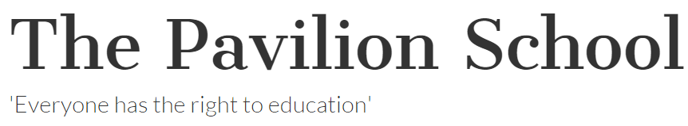
CURRENT HOST EMPLOYERS
Notes:
Presentation text / body
To create additional slides – Mouse > Right click > Duplicate slide

Slide 10
BENEFITS
Future employment
Hands on experience
Contacts/ networking
Nationally recognised qualification
Paid whilst you learn
Academic pathways – guaranteed entry to University Partners (certificate IV) + course credits (diploma)
Notes:
Presentation text / body
To create additional slides – Mouse > Right click > Duplicate slide

Slide 11
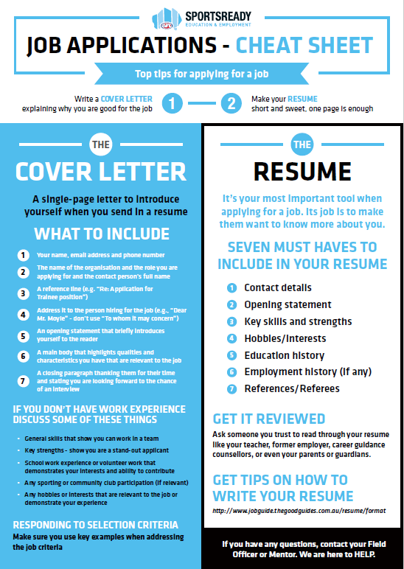
Notes:
Presentation text / body
To create additional slides – Mouse > Right click > Duplicate slide

Slide 12
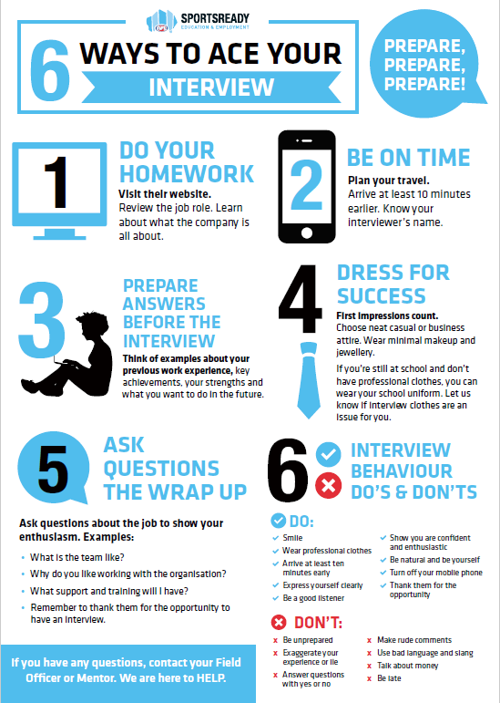
Notes:
Presentation text / body
To create additional slides – Mouse > Right click > Duplicate slide

Slide 13
ARE YOU INTERESTED ???
Please contact me and send me your resume details asap !!
Either call me to discuss your areas of interest on 0418 109 704 or email me on ;
peter.Filandia@aflsportsready.com.au

Slide 14
HOW TO GET A TRAINEESHIP
Visit www.aflsportsready.com.au
If you see a position that interests you on the AFL SportsReady “Jobs board”, apply online.
You may be asked to come into the AFL SportsReady office to have a pre-screen meeting with the relevant field officer.
If you are suitable for the job, you may be asked to attend a formal interview with the Host Employer
Start writing your résumé and cover letter NOW
Notes:
Presentation text / body
To create additional slides – Mouse > Right click > Duplicate slide

Slide 15



FOLLOW US
Please follow us on Facebook, Twitter and Instagram
AFL SportsReady
ArtsReady
@AFL SportsReady
@ArtsReadyAU
AFL SportsReady
ArtsReady
Visit our website for more information www.aflsportsready.com.au

