Slide 1
YEAR 1 INFORMATION EVENING
Teachers:
Ms Karin Ilich
karin.ilich@cewa.edu.au
Miss Jessica Saraco
jessica.saraco@cewa.edu.au
Education Assistant:
Ms Clare McKeague

Slide 2
JOHN XXIII COLLEGE
PRAYER
Lord, you gave our founders a sense of vision and action.
As members of the John XXIII College Community, we pray for:
Competence to do our work well
Conscience to live in truth
Compassion to open our hearts to those in need, and
Commitment to respond to God at all times.
May our happiness come from the joy of serving others.
As we plan for tomorrow and live our lives today, may we seek justice.
Pope John XXIII - Pray for us
Ignatius of Loyola - Pray for us
Mary Ward - Pray for us

Slide 3

RELIGIOUS EDUCATION
Daily Prayers
Mother’s Day Mass: Friday 11th May (Term 2, Week 2)
TOPICS
Term 1: Growing and Changing
Lots of Learning
A Special Holy Time
Term 2: Wonder World
We Belong
Friends Together
Term 3: Just Imagine
We Make Choices
Loving Others
Term 4: Prepare
To Love by Working
I am Special

Slide 4

LITERACY GOALS
Speaking and Listening
Reading
Writing

Slide 5

NUMERACY GOALS
Number and Algebra
Measurement and Geometry
Statistics and Probability

Slide 6
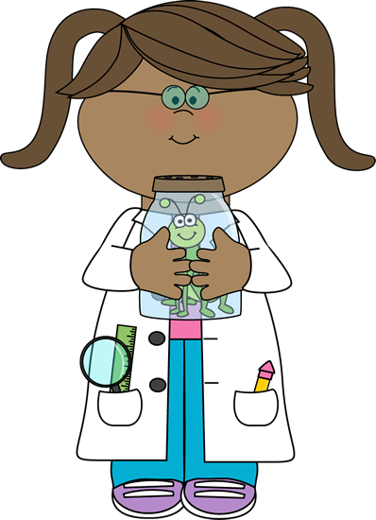
INTEGRATED STUDIES
Science
Term 1: Earth and Space
Investigating changes in the sky and landscape
Term 2: Biological
Investigating living things (Minibeasts)
Term 3: Physical
Investigating light and sound
Term 4: Chemical
Investigating physical changes in everyday materials

Slide 7
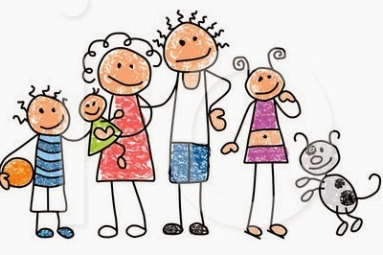
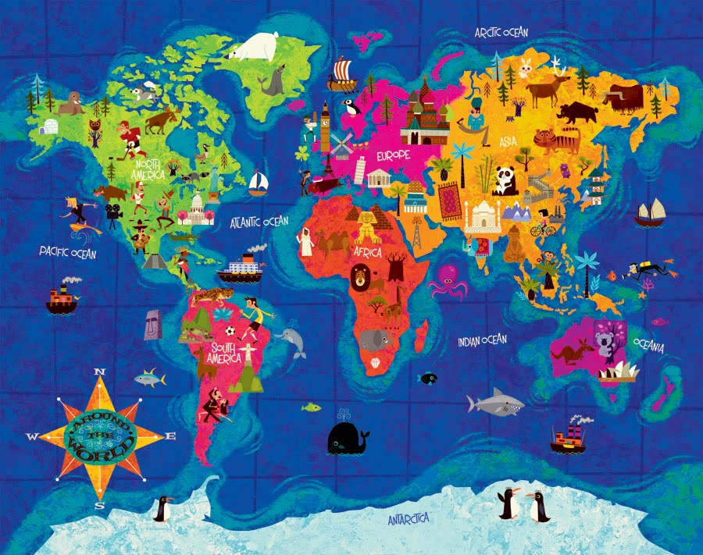
INTEGRATED STUDIES
History
Term 1: Family Structures
Term 2: Language of Time and Important Events (Celebrations)
Geography
Term 3: Natural, Managed and Constructed Features
Term 4: Activities in a Community

Slide 8
INTEGRATED STUDIES
Health - Keeping Safe Program
The two Keeping Safe Themes are:
· Theme 1: We all have the right to be safe
· Theme 2: We can help ourselves to be safe by talking to people we trust.
They are explored through four Focus Areas, which are:
· Focus Area 1: The right to be safe
· Focus Area 2: Relationships
· Focus Area 3: Recognising and reporting abuse
· Focus Area 4: Protective strategies

Slide 9

GROSS MOTOR DEVELOPMENT
Physical Education (with Mr Alderman)
Class Sport
Friday Fitness
Morning Movement

Slide 10

REPORTING AND ASSESSMENT
Term 1: Parent Meetings
Term 2: SEQTA Reports
Term 3: Open Night
Term 4: SEQTA Reports

Slide 11

ASSEMBLY
Term 3, Week 9, 14th September

Slide 12



SPECIALISTS
Monday | Tuesday | Wednesday
Physical Education Mr Alderman | Digital Technologies Mrs Purcell | Japanese Mrs Rowson
 | Music Mrs Morell | Library and Drama Mrs Cattapan

Slide 13

BEHAVIOUR MANAGEMENT
Encourage Positive Behaviour
Classroom Management of Poor Behaviour

Slide 14
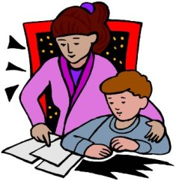
HOMEWORK
15 minutes
1. Nightly Reading (Monday-Thursday)
2. Maths
3. Oxford Sight Word Spelling and Reading
Extras:
Mathletics
Raz-Kids
Literacy Planet

Slide 15

PARENT HELP
Reading Roster (Begins Wednesday,Week 3)
Five parent helpers per morning (Tuesday to Friday)
8.35am-9.00am
Excursions and Incursions

Slide 16
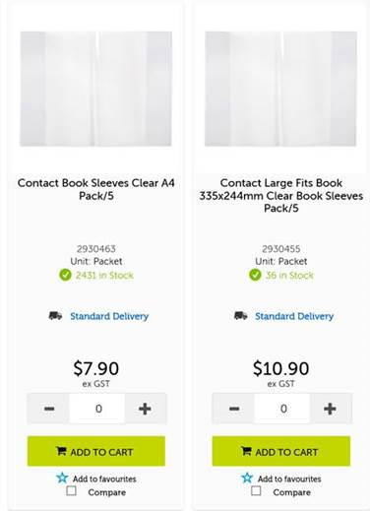
PARENT HELP
Contacting Books
Option 1.
Use contact
Option 2.
Use Contact Book Sleeves (from
OfficeMax)
A4 Code-2930463
A3 Code-2930455

Slide 17
COMMUNICATION
Teacher communication
Absentees
Late arrival
Appointments

Slide 18

EXPECTATIONS IN YEAR ONE
Independence
Building Resilience
Social Development

Slide 19
HEALTH AND HYGIENE
Medical conditions
Allergy Aware School
Hygiene awareness
Birthdays

Slide 20

WHAT WENT WELL TODAY?

Slide 21
PARENT REPRESENTATIVES
Introductions

Slide 22
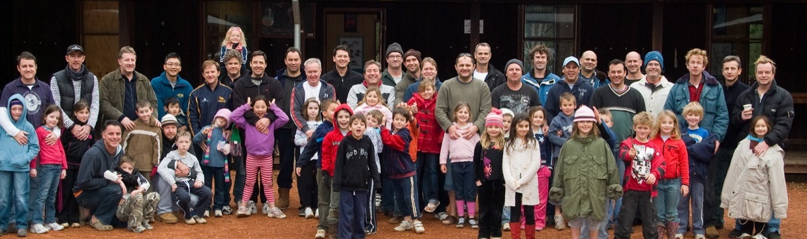
Men of John XXIII College
Who We Are and What We Do
“It is easier for a father to have children than for children to have a real father”
Pope John XXIII

Slide 23

WE LOOK FORWARD TO A WONDERFUL YEAR OF LEARNING!
THANK YOU

